Slide 1
Introduction to WFP
October 3rd 2013

Slide 2
WFP’s Vision
A world in which every man, woman and child has access at all times to the food needed for an active and healthy life

Slide 3
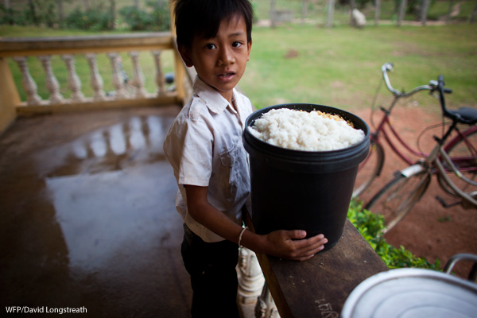
Hunger - the global scope
842 million hungry and undernourished (FAO 2013)
3.5 million children under 5 die every year from malnutrition-related causes, a third of all child deaths
Hunger is the world’s no. 1 health risk killing more people every year than AIDS, malaria and tuberculosis combined

Slide 4
About WFP
The world's largest humanitarian agency fighting hunger worldwide
Established in 1962
HQ in Rome
WFP relies entirely on voluntary contributions to finance its humanitarian and development projects. Total contributions in 2012: US$ 3,350,332,510
Around 12,000 staff members across the world, of whom most are working on the field. Small office in Copenhagen, with 6 people in total

Slide 5
About WFP
In emergencies WFP gets food to where it is needed, saving the lives of victims of war, civil conflict and natural disasters
After the cause of an emergency has passed, food is used to help communities rebuild their shattered lives
On average, WFP assists more than 90 million people in more than 70 countries each year.

Slide 6
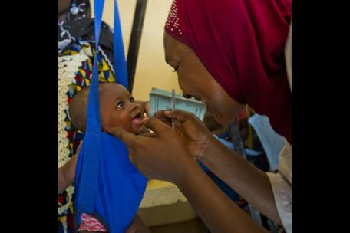
Want to know more?
Homepage:
www.wfp.org
Facebook:
https://www.facebook.com/WorldFoodProgramme
Twitter:
@WFP

