Slide 1
Unite and Deliver How UN organizations can work together and provide better support to countries
unite and deliver effective support for countries
Notes:
This presentation explains elements of UN reform and System-wide Coherence that relate to UN operational activities for development.
How to use this Presentation
Use “presenter view” when showing it so you can read the notes.
Print the notes pages as a script for yourself and a handout for audiences.
For a 45-minute presentation use the whole deck., spending no more than 30-60 seconds on each slide
For a 5-10 minute presentation read only the key points on the slides or select the key points that you want to make.
There are specific supplementary PPT slides for UN staff, Programme Countries and Donors – be sure to use the appropriate ones for your audience.
Hide or delete any slides that aren’t relevant to your audience.

Slide 2
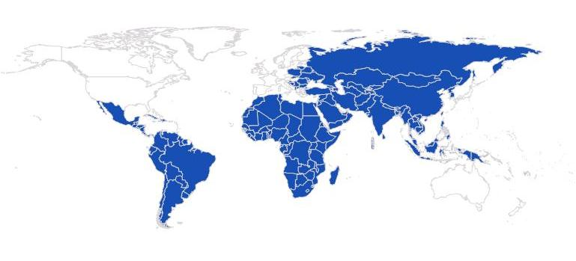
The UN system’s global presence gives it unique advantages in supporting countries.
UN Programme Countries
Notes:
UN system – has a unique advantage in helping countries to develop. It has a unique depth of capacity and a breadth of voice.
Global presence, 135 country teams conducting activities worth over $19 billion each year to promote social and economic progress.
Support is universal, multilateral, impartial, and flexible.
Guided by a globally agreed normative framework of human rights and development goals.
Assistance is unconditional assistance and follows national priorities.
This translates into a unique ability to link national and international goals, both in advice and implementation.

Slide 3
The UN Development Group unites the 32 UN organizations that play a role in development.
Notes:
The breadth and diversity of the UN system is also a weakness, because it’s often difficult for these very different organizations to plan and work together strategically.
Some donors still see the UN’s field operations as too cumbersome and plagued by duplication in programming.
Developing country governments, particularly small ones, often find dealing with the UN incurs excessive transaction costs.
Cooperation is hindered by competition for funding, governance bodies that set divergent priorities, and different business practices.
Even when mandates intersect, UN organizations tend to operate alone with little synergy and coordination between them.

Slide 4
The UN is a small fish in a big funding pool

Slide 5
The average number of donors per country is growing.
1960s
2001-2005
Notes:
The international aid architecture has changed dramatically.
Now many more donors, including middle income countries with different approaches.
Funding patterns are changing significantly. A bigger share of aid is going directly to governments’ budgets, to vertical funds and to small NGOs. Donors have many more choices about where to put their money.
Multilateral aid agencies (around 230) outnumber donor and recipient countries combined.
Average of 12 donors per country in the 1960s
Average of 33 donors per country in 2001-2005
Pakistan had 23 Un Agencies present…
Private and “emerging” donors
More donors, smaller projects = growing fragmentation
Difficult for local governments to drive the agenda

Slide 6
The High-Level Panel on UN System-wide Coherence proposed creating pilots.
Notes:
So the UN system was challenged.
Based on the agreements made by UN Member States at the 2005 World Summit, the Secretary-General formed a High-Level Panel on System-wide Coherence to consider major reforms on how the UN system works in the fields of development, humanitarian assistance, and the environment.
Its report, “Delivering as One,” was released in November 2006.
The High-Level Panel offered a number of recommendations. For development operations, it organized its proposals around four “ones.”
One Programme
One Leader
One Budgetary Framework
One Office
The panel proposed the launch of “Delivering as One” pilot exercises, in which selected UN Country Teams would put the four ones into practice.

Slide 7
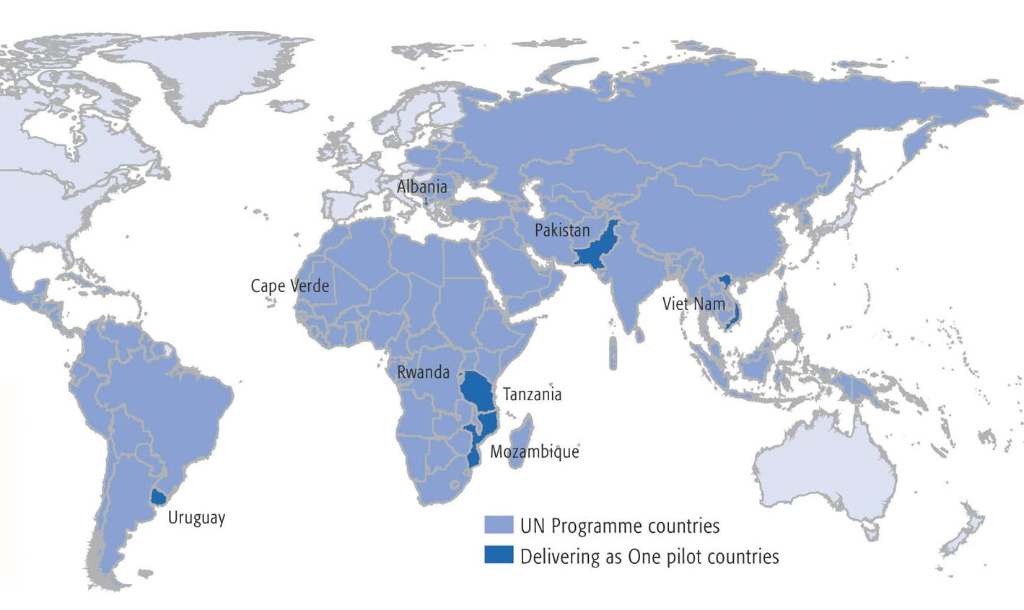
In 2007 eight pilot countries volunteered to test Delivering as One.
Notes:
When the Secretary-General launched Delivering as One, the governments of eight countries — Albania, Cape Verde, Mozambique, Pakistan, Rwanda, Tanzania, Uruguay, and Viet Nam — volunteered to become “Delivering as One” pilots.
The pilot countries agreed to work with the UN system to capitalize on the strengths and comparative advantages of the different members of the UN family.
Together they are experimenting with ways to increase the UN system’s impact through more coherent programmes, reduced transaction costs for governments, and lower overhead costs for the UN system.
It is critical to emphasize here that the objective of these efforts is to deliver as one – working and planning together in a coordinated way to reduce duplication, increase efficiency, and encourage donors to pool their funds so we can be more strategic and deliver real impact.

Slide 8
One-UN in the UN City
Notes:
8 UN Organisations a gathered in the UN City in Copenhagen
The UN City building supports the reform efforts in the UN system, including the One UN appraoch, which entails a more coordinated, efficient and collaborative UN Sytem
Being united in the same building saves the organisations not only resources for administration costs, but also facilitates and enhances cross-organisational learning and cooperation.
In the UN City we do not work jointly on prgrammes - that is what we do in programme countries, with the Delivering as One appraoch.
But we work together on other things:
UN City Common Services:
Reception
Driving
Canteen
Security
Mail services
Travel, IT and HR
Further to this we work on:
Joint porcurement – eg. Greening of the health procurement initiative
Joint Communicatoin initiatives – eg. The UN City is open to the public on Copenhagen Culutre Night which is on the 11th of October
Interagency working groups – eg. Greening of the UN City - Sustainability campaign
Challenges in UN City:
No joint programming
We are a groupd of apples and bananas. WHO is a regional office for Europe. UNOPS has it’s Headquarters in Copenhagen and organisation such as UNDP, WFP, UNFPA, UNWOMEN hos representation officere here. Our mandates and targetgroups vary.
Challenges with One UN Reform on country level:
When you work jointly you loos some of your profile (identity) and it becomes more difficult to raise funds
Resident Coordinator funtion is key. Good RCs make things move.
Funding is a challenge – Delivering as one has been most efficient when donors have given resources to One UN funds. That makes the UN Organisations cooperate imediately.

Slide 9
Thank You
unite and deliver effective support for countries
Unite and Deliver

