Slide 1
2015: A perfect storm? Political and social trends in Tanzania
Ben Taylor
for Society for International Development
Copenhagen
November 12, 2013

Slide 2
Global
Regional
Tanzania
International Politics
Economics
Society
National Politics
Party politics
Religion?
Growth
Media
Poverty
Human rights
Tax
Constitution
Natural resources
Corruption
Demo-graphics
Public services

Slide 3
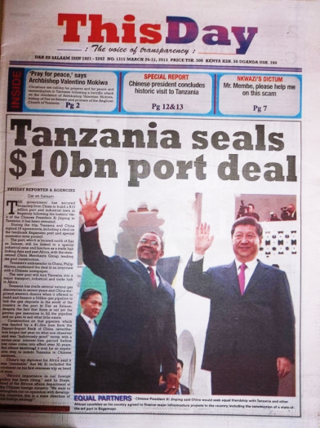
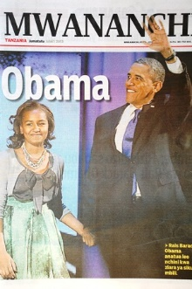
International Politics
Global
Notes:
Xi Jinping’s visit in March 2013, ten days after taking office; Obama’s visit in July.
Chinese port deal alone worth $10bn – we guess. Obama’s “Power Africa Initiative” worth roughly $1bn to Tanzania
Chinese investments in mining, energy, transport,

Slide 4
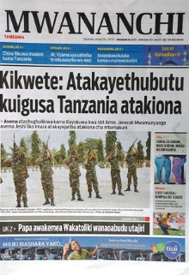
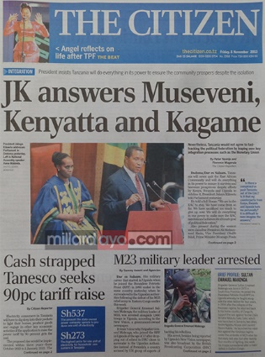
International Politics
Regional
Notes:
customs/trade, immigration, transport initiatives, land, employment, Rwanda-DRC-M23, Kimbunga, Malawi (oil)

Slide 5
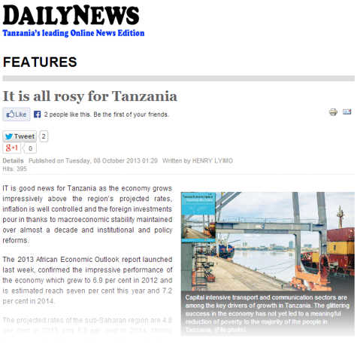
Economics
Growth
Notes:
Great overall growth figures: around 7% for past decade

Slide 6
Economics
Growth
Source: Afrobarometer survey, 2012
Notes:
But people are not feeling it:
Less Tanzanians (8%) were positive about the current state of the economy than in any other surveyed country.
Twice as many Tanzanians said that they thought the economy had got worse in the past twelve months (51%) as said it had got better (25%).
Less Tanzanians (22%) said that they expected the economy to improve in the coming twelve months than in any other country.

Slide 7
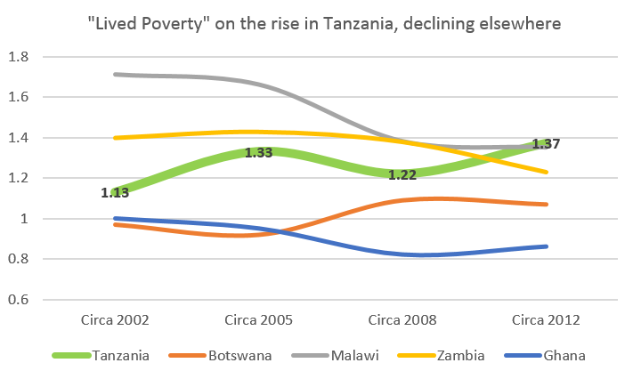
Economics
Poverty
Source: Afrobarometer surveys, 2002-2012
Notes:
With good reason
Based on “how often had you had to go without water/food/money/medicines?”

Slide 8
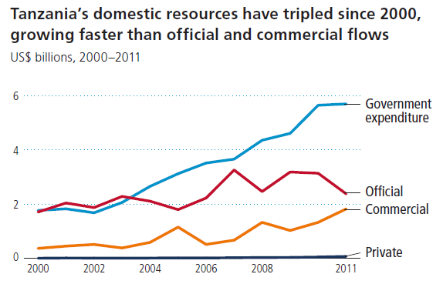
Economics
Tax
Tax
Aid
FDI
Remittances
Source: Investments to End Poverty (Development Initiatives)
Notes:
This is a really important slide. Ten years ago, aid was most important. Now, tax and FDI are what really counts. Side note on remittances.
Business is booming. International commercial resources (largely foreign investment) is fast catching up with aid.
Tax 3 – 1 Aid. Domestic resources are more important than aid for poverty reduction in Tanzania, and becoming even more so.
Remittances nil. Tanzania get’s almost nothing in private resource flows. In fact, for remittances, more than 3 times as much leaves Tanzania as enters.

Slide 9
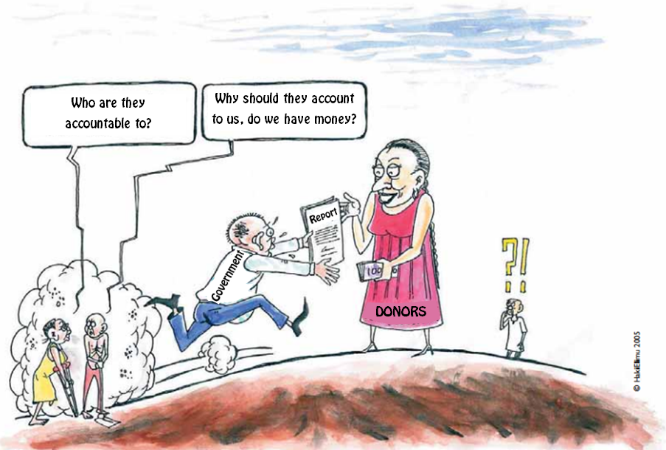
Economics
Tax
Source: HakiElimu
Notes:
This helps to explain why the previous slide matters.
It’s about accountability.
“No taxation without representation” used to be a campaign slogan, but in fact, no representation without taxation would be a more accurate description of the real world.”
Tz govt’s primary accountability was previously to donors, this is no longer the case.
Now accountability more likely to be domestic, (or to China).

Slide 10
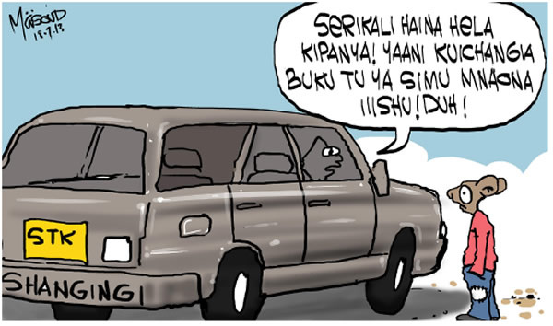
Economics
The government has no money, Kipanya! And you think even paying 1,000 shillings is an issue?
Tax
Source: Kipanya
Notes:
Accountability is changing.
New taxes, tax increases are hotly contested, hotly political.
In a survey by Twaweza, 83% disagreed with the tax.

Slide 11
$3bn in 2020
Estimate based on IMF projections of government revenue from natural gas
Economics
Natural Resources
Source: TMAA / IMF
Notes:
Not just about taxing citizens. Revenue from minerals is about to skyrocket:
Estimated 41.7 trillion cubic feet of natural gas discovered - 5th in Africa, after Nigeria, Algeria, Egypt, Libya (Ministry of Energy and Minerals)
By 2020, mineral revenues expected to exceed aid. Estimated revenue to govt by 2020 of $2.5bn per year
Policy and contract discussions underway, at pace
Concern that lessons from earlier mistakes (esp. in gold mining) have not been learnt
Lack of transparency / clarity in the process

Slide 12
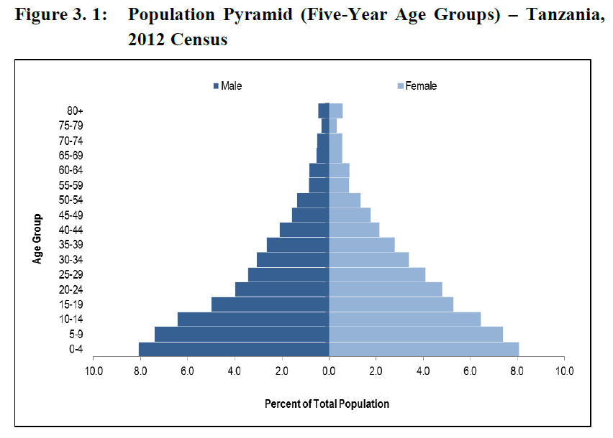
Society
Demo-graphics
Source: 2012 Census
Notes:
The effect of this is already visible: youth (more than half the electorate are under 35). Politicians can win by appealing only to young people.
Young politicians (esp. January Makamba, Zitto Kabwe) on the rise, tapping into youth vote. Chadema’s “base”

Slide 13
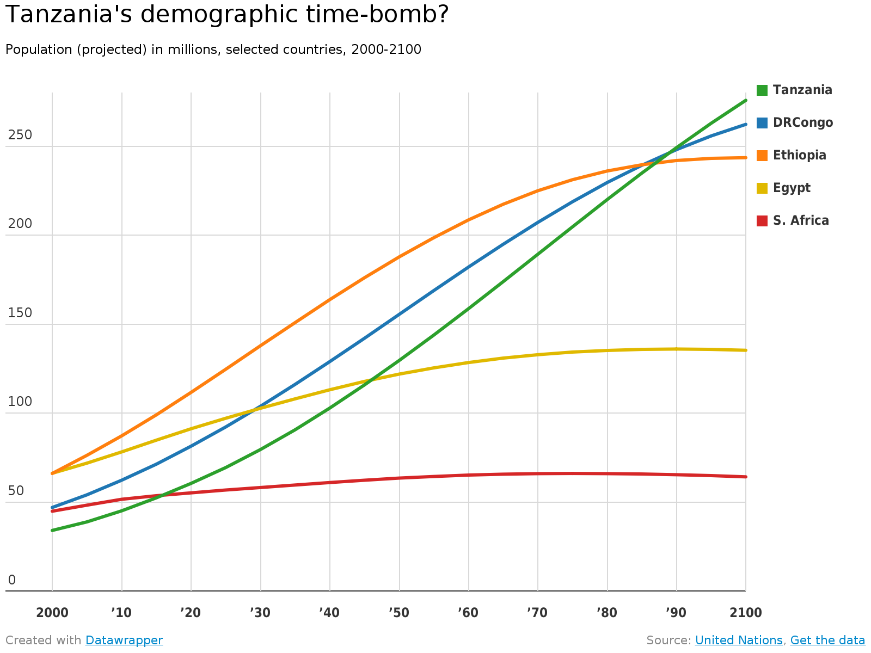
Society
Demo-graphics
Source: UN
Notes:
(Only Nigeria out “ahead”)
The effect of this is already visible: pressure on land (politics of land grabs / ownership), water, public services

Slide 14
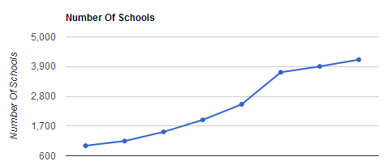
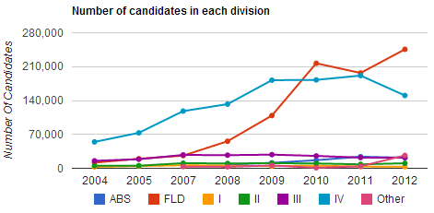
Society
Public Services
Source: shule.info
Notes:
Uwezo surveys (Twaweza): 7 out of 10 standard 3 pupils cannot read in Swahili; 9/10 in English; 7/10 can’t do basic maths

Slide 15
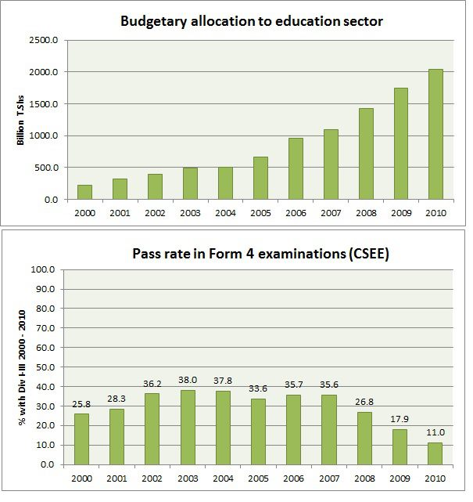
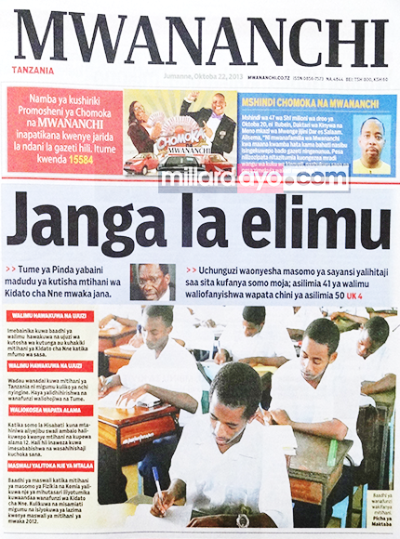
Society
Public Services
Notes:
Could equally show how access to clean and safe water in rural Tanzania is declining
(though there has been some very good progress in health – malaria, maternal mortality, etc.)

Slide 16
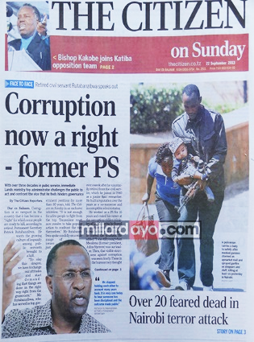
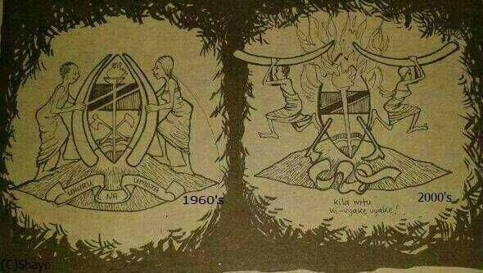
National Politics
Corruption
Notes:
EPA/BoT, Radar/BAE, Richmond/Dowans – it pervades government, pervades politics – both grand and “petty” corruption.
A very real sense that Tanzania has “squandered” its national spirit – that there was a “collective nation-building project” in previous generations that has now been lost.
A lot of politics is apparently about “fighting corruption”, but politics is corrupt
TAKUKURU is ineffective, “hands tied” – Wikileaks / HOSEA story
Frustrated electorate – blames corruption for everything

Slide 17
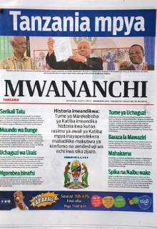
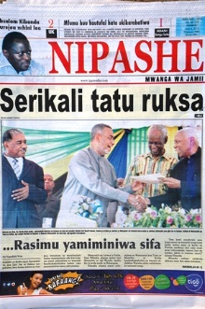
National Politics
Constitution
Notes:
Government response to pressure from opposition to revisit constitution (Kenyan example), to reduce presidential power, greater respect for human rights
Current draft does very little on these issues, but focusses on the relationship between Zanzibar and the mainland
Having an unsettling effect on politics – no-one knows what the structure of government / voting system will be at next election, or whether the process will be complete in time.

Slide 18
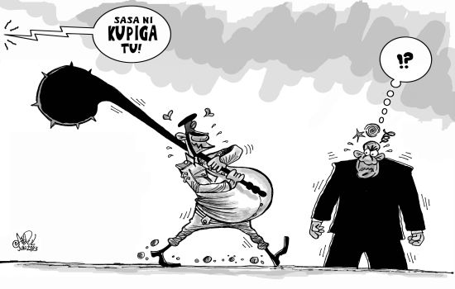
Political rights
National Politics
Human Rights
Notes:
Response to unrest in Mtwara, related to politics of gas;
Attitude of political leaders does not respect human rights

Slide 19
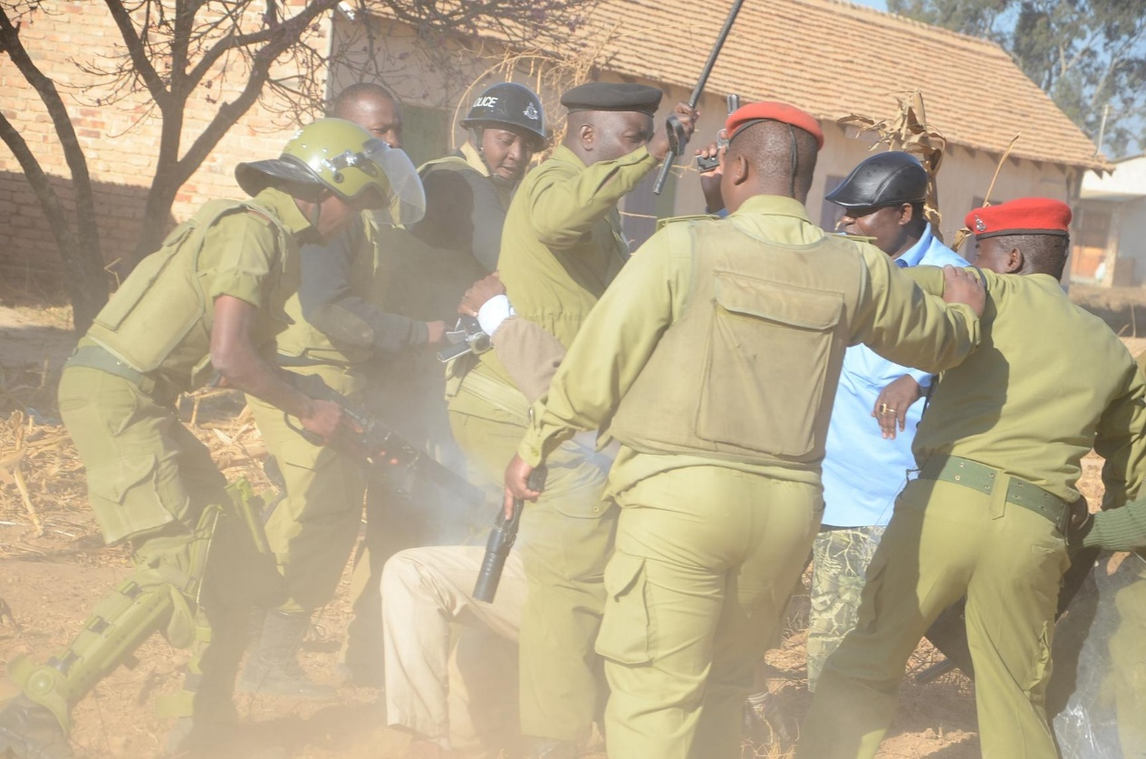
National Politics
Media
Notes:
Mwangosi

Slide 20
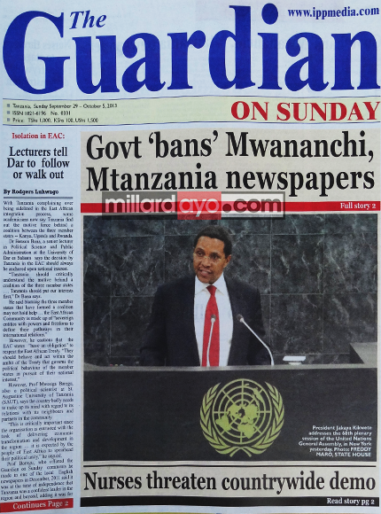
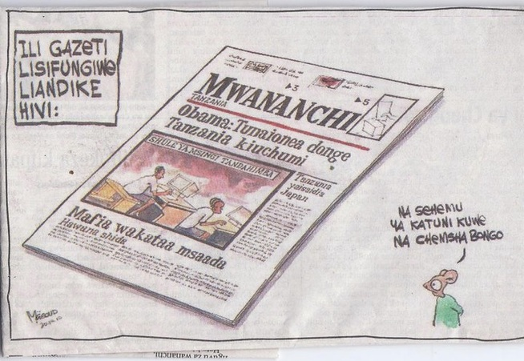
National Politics
Media
Notes:
Media law
repressive laws, ministerial discretion,
moves to restrict media further

Slide 21
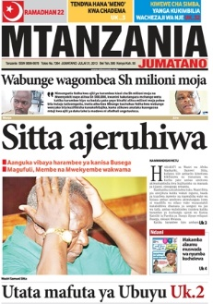
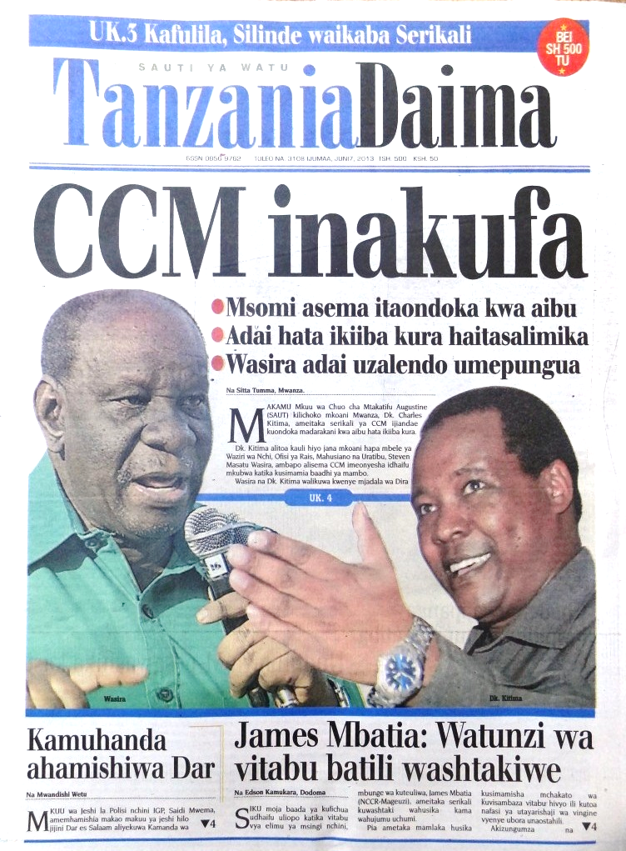
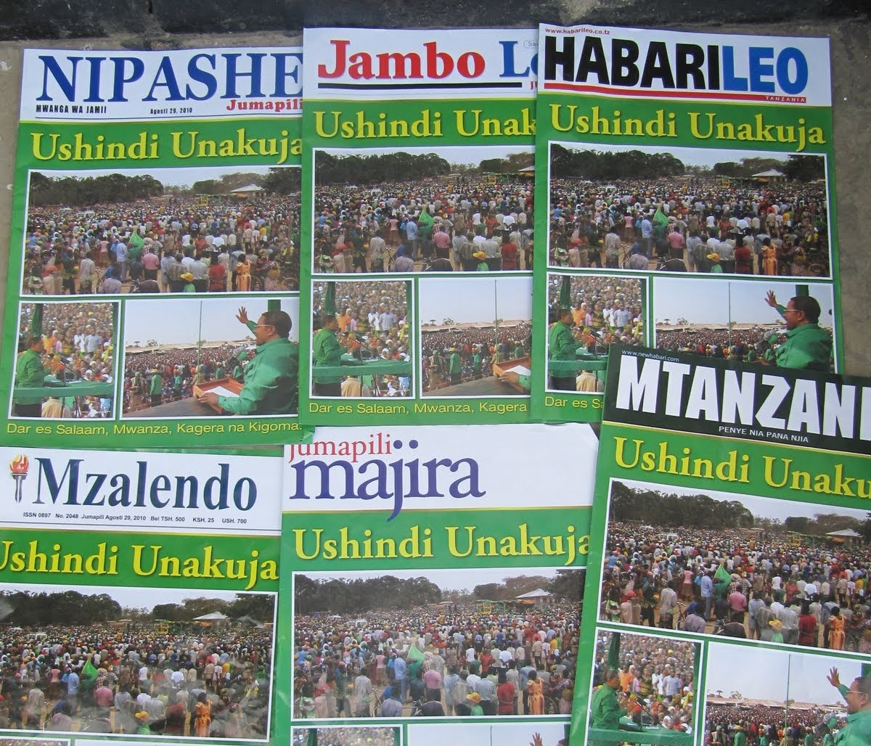
National Politics
Media
Notes:
The media is far from being an independent observer, representing the community.
Almost every news outlet (and every journalist) has its political affiliations and/or can be bought for very little money.

Slide 22
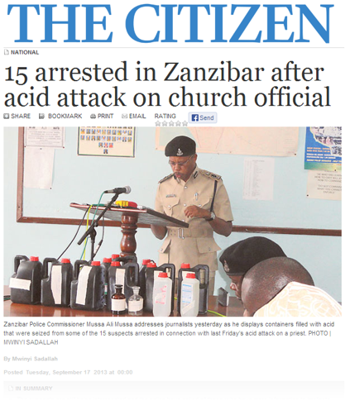
National Politics
Religion?
Notes:
Religious tensions get a lot of attention, but arguably overhyped
Some violence, but generally religious tolerance remains strong
Tensions used by politicians to justify clampdowns on the media, protests, etc.

Slide 23
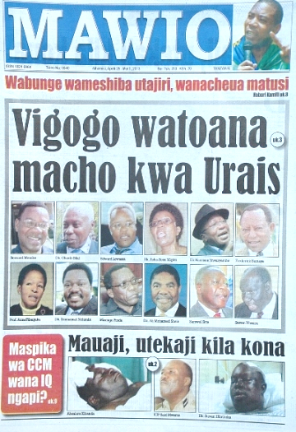
National Politics
Party politics
Notes:
It’s all about 2015. Part 1 - internal party politics within CCM

Slide 24
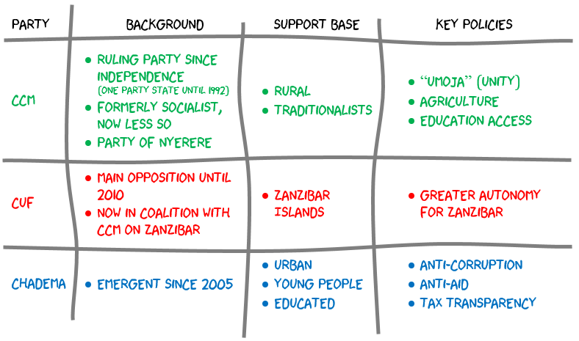
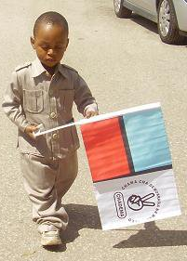
National Politics
Party politics
Notes:
Three main parties, though there are others.
Personality politics
Shorthand
Use of “Umoja” to challenge dissent
Lack of realism (and experience) in Chadema policies

Slide 25
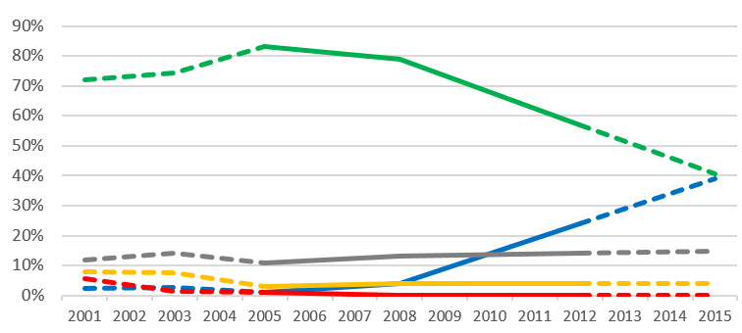
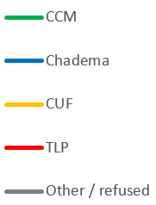
National Politics
Party politics
data from 2001-2003 is speculative, based on a different survey question
Notes:
It’s all about 2015. Part 2 - for the first time ever, there is a realistic choice.
Chadema are a serious party, with a serious opportunity to well in 2015. Very well tapped into youth, urban, educated.

Slide 26
Looking east
Tax and gas, not aid
Strain on land & public services
Reduced political space
Increased political competition
2015: Tanzania’s perfect storm?
Asanteni
Ben Taylor
@mtega
btaylor@twaweza.org
www.mtega.com
www.twaweza.org

