Slide 1
Coming to africa
To do business in East Africa

Slide 2
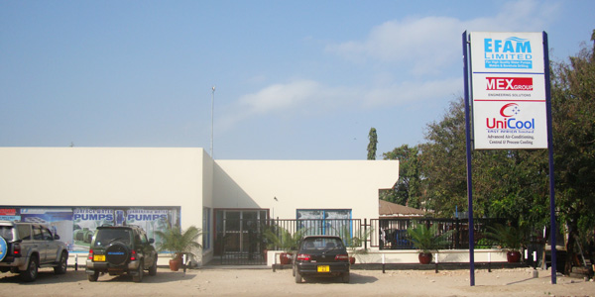
Agenda
A short description of us
Our international experience
The African Development
Our goals in Africa
Advantages of doing business in East Africa
SWOT of UniCool in Africa
Outlook
Our experiences
Questions
Our office in Das es Salaam, Tanzania

Slide 3
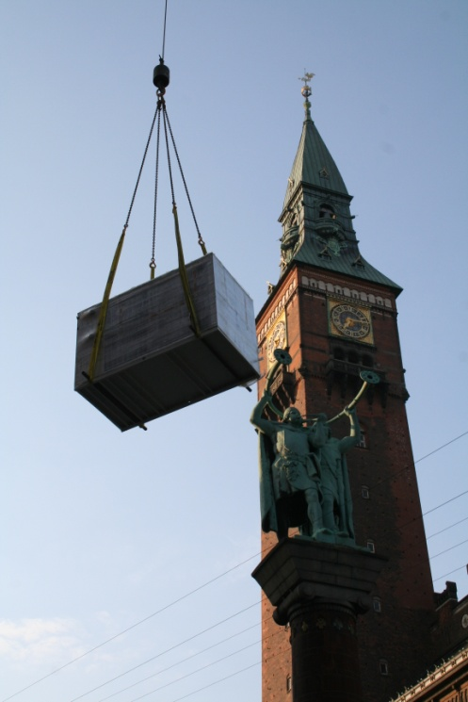
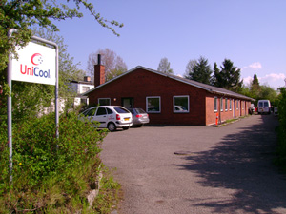
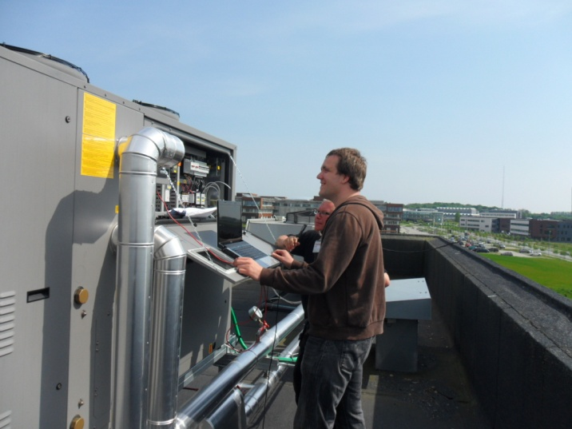
About UniCool
Danish company established in 2000 and today employs 16 people in this country against 60 people in East Africa
Our headquarters is located at Lerhøj 5 in Bagsvaerd
On a daily basis we deal in the sales, design, installation and servicing of cooling systems
International turnkey solutions

Slide 4
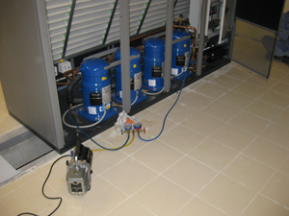
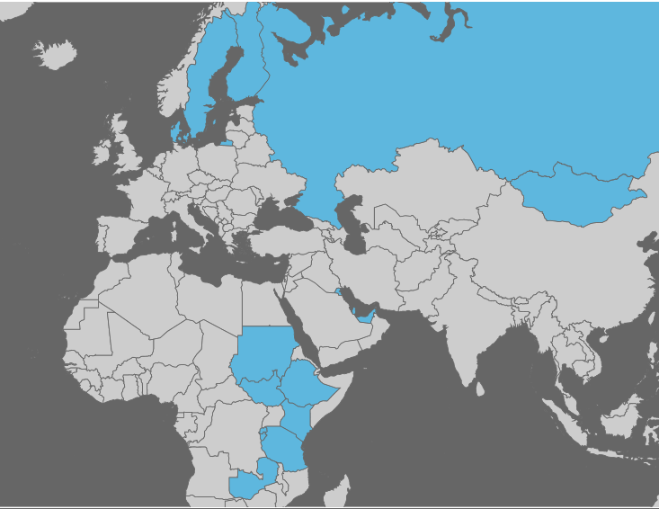
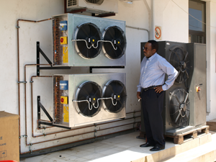
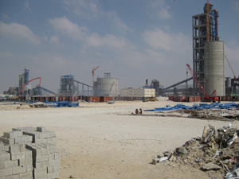
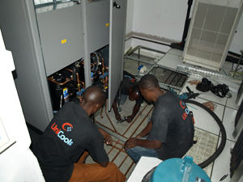
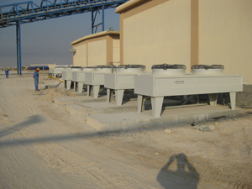
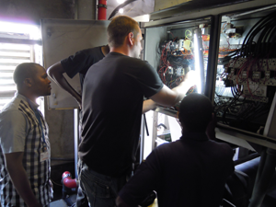
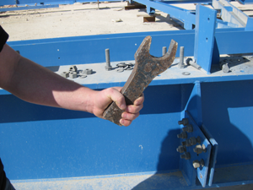
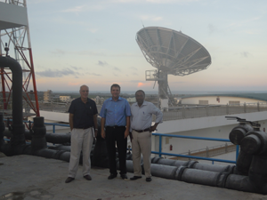
Our international experience

Slide 5
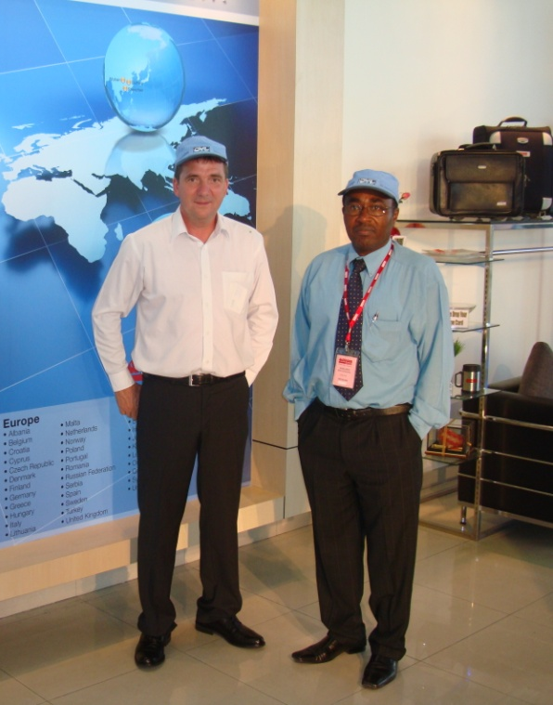
The African Development
2005: Our CEO Ole Hoffmann Hansen was presented with the opportunity to start a joint venture in Africa.
2006: UniCool East Africa Ltd. was registred between Ole Hoffmann Hansen & our local partner Mohamed Rweyemamu. Mr. Rweyemamu acts as managing director of the company.
2008: UniCool East Africa finished installation of a chilled water cooling system for Vodacom's new switch. The contract was worth about $ 1.5 million and UniCool has performed the post-sale service for the site.
2009: UniCool A/S (Denmark) becomes ISO 9001:2008 certified.
2009: A new company, UniCool International Ltd. is established in Kenya.
2012: A new company, UniCool Rwanda Ltd. is established in Rwanda.
2012: A collaboration between UniCool A/S and UniCool East Africa Ltd. to design and install fire equipment, electrical systems and cooling equipment for 3 large data centers located in different sites in the Sudan. The Export Credit Agency (EKF) provided working capital.

Slide 6
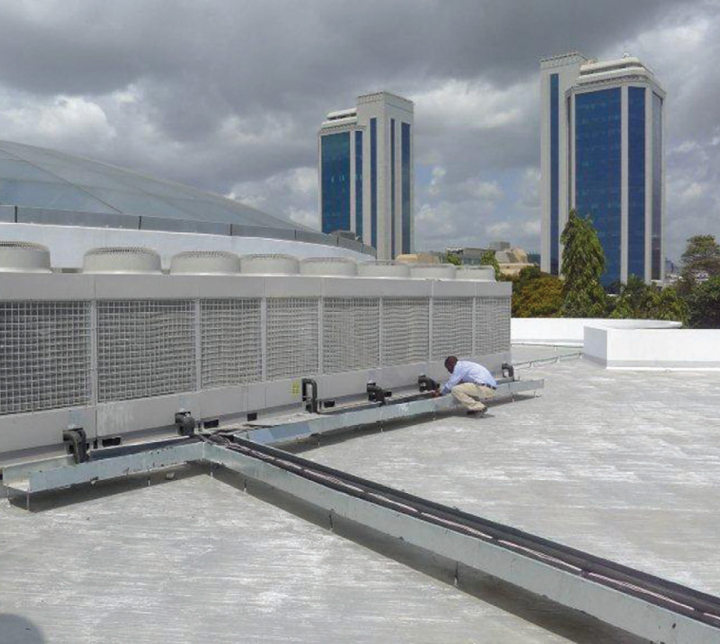
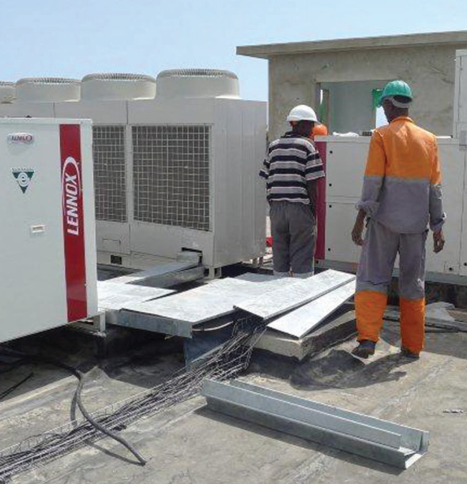
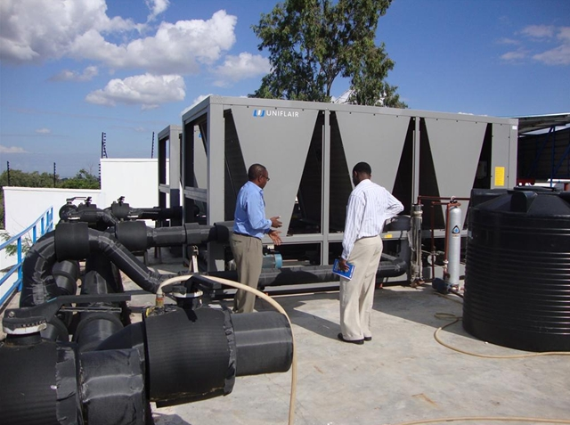
Our goals in Africa
Creating a profitable company with local labor.
Creating local jobs with the possibility of training in complicated cooling solutions
Delivering technically complex cooling solutions with a focus on energy efficiency and use of environmentally friendly refrigerant, while still ensuring locally available support.
Working in Africa by European standards

Slide 7
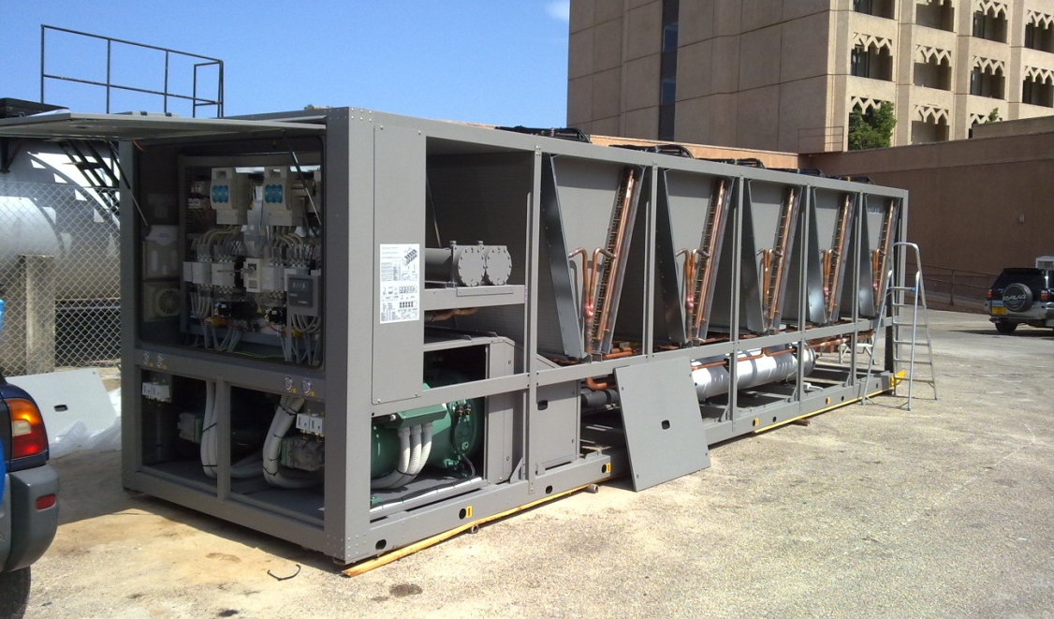
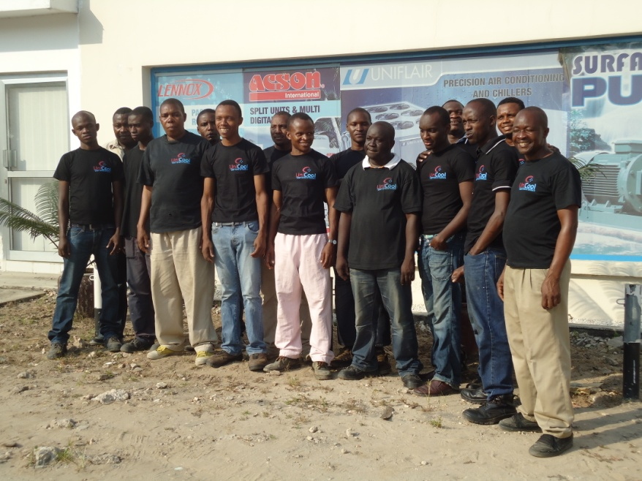
Our view on benefits in Africa
High growth has provided us with many opportunities
The time zone fits well with Denmark, which makes cooperation between the continents easier
Motivated workforce available locally
Local workforce is skilled in English and a good cultural fit for our Danish employees

Slide 8
SWOT analysis of UniCool in Africa
The company is registered as a Class 1 Special Contractor in Tanzania which allows UniCool to bid
on public tenders above $250,000 USD, something only few other HVAC companies in Tanzania has.

Slide 9
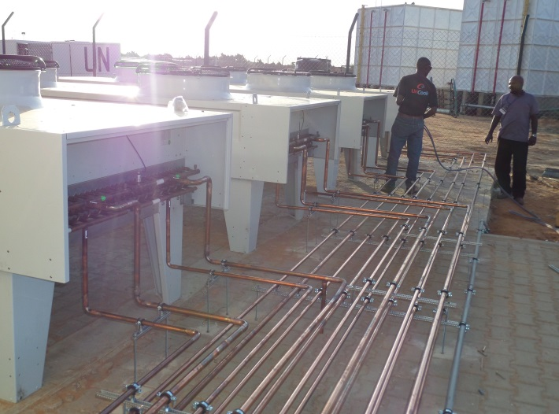
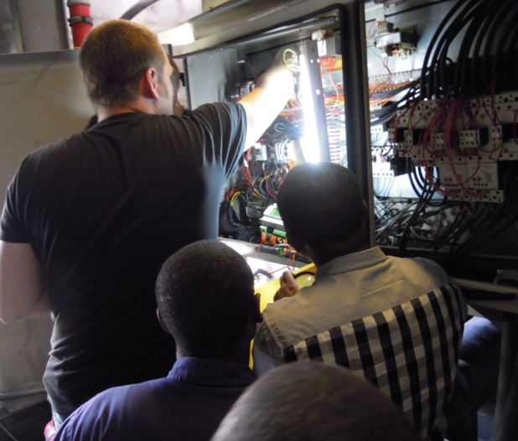
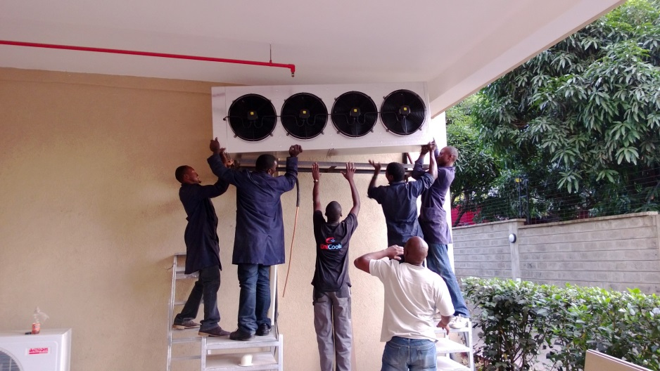
The Future
Launched Energy Consultancy in Denmark, with plans to export this service to Africa.
Improving internal QMS systems
First major contract won by UniCool Rwanda Ltd.

Slide 10
Our experience and advice to you for doing business in East Africa
Patience, patience, patience and more patience
Focus not only on the technical aspects, but the whole business structure and especially a good financial system
Stationed people need to have some adventurous spirit and good sense of self-discipline.
Find the right partner whose personality fits well with your employees, as there “probably” will be challenges. (A partnership is like a marriage)
Remember to respect other cultures! You are coming to their country, not vice versa.
In East Africa, there is an African sense of time (appointment times can fluctuate around 1-2 hours), that's life.

Slide 11
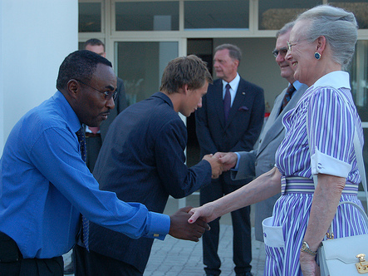
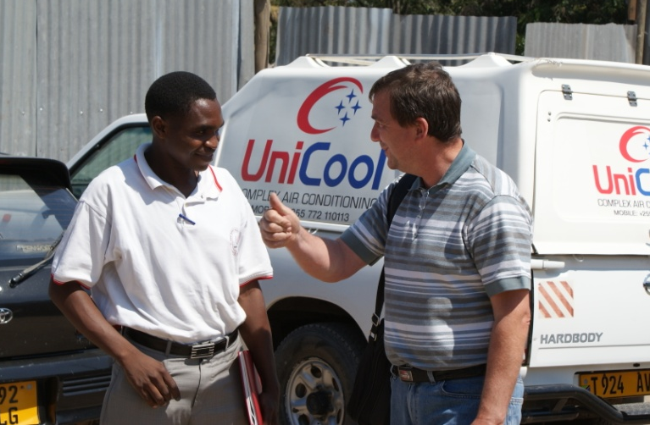
Our experience and advice to you for doing business in East Africa
Be prepared for hard work before results begin coming in, everything takes more time than planned.
Many customers are very late with payment.
The market has virtually no warranty, so customers are accustomed to suppliers running out on responsibility and furthermore, the legislation is not effective for chasing them down. Therefore, our experience is that new products are difficult to sell. The best marketing is good local recommendations.
There are many great opportunities and experiences to be had.

Slide 12
On the top of Africa
Many thanks for your time and attention, now is the time for questions

