Slide 1

INVESTING
FOR
SOCIAL
IMPACT
IN AFRICA
IDA Global Development 24 January 2018.

Slide 2
AGENDA
Nordic Impact Funds
  – who we are and what we want to achieve?
The opportunity
  – growth and market perspectives
The solutions
  – trends and challenges
The cases
  – examples from East Africa
Discussion

Slide 3
NORDIC IMPACT FUNDS IN BRIEF
Creating a positive impact for more than a million lives in East Africa
by leveraging the best of the Nordics - governance, capital, technology, and expertise
and combining it with African presence, deal experience and local network

Slide 4
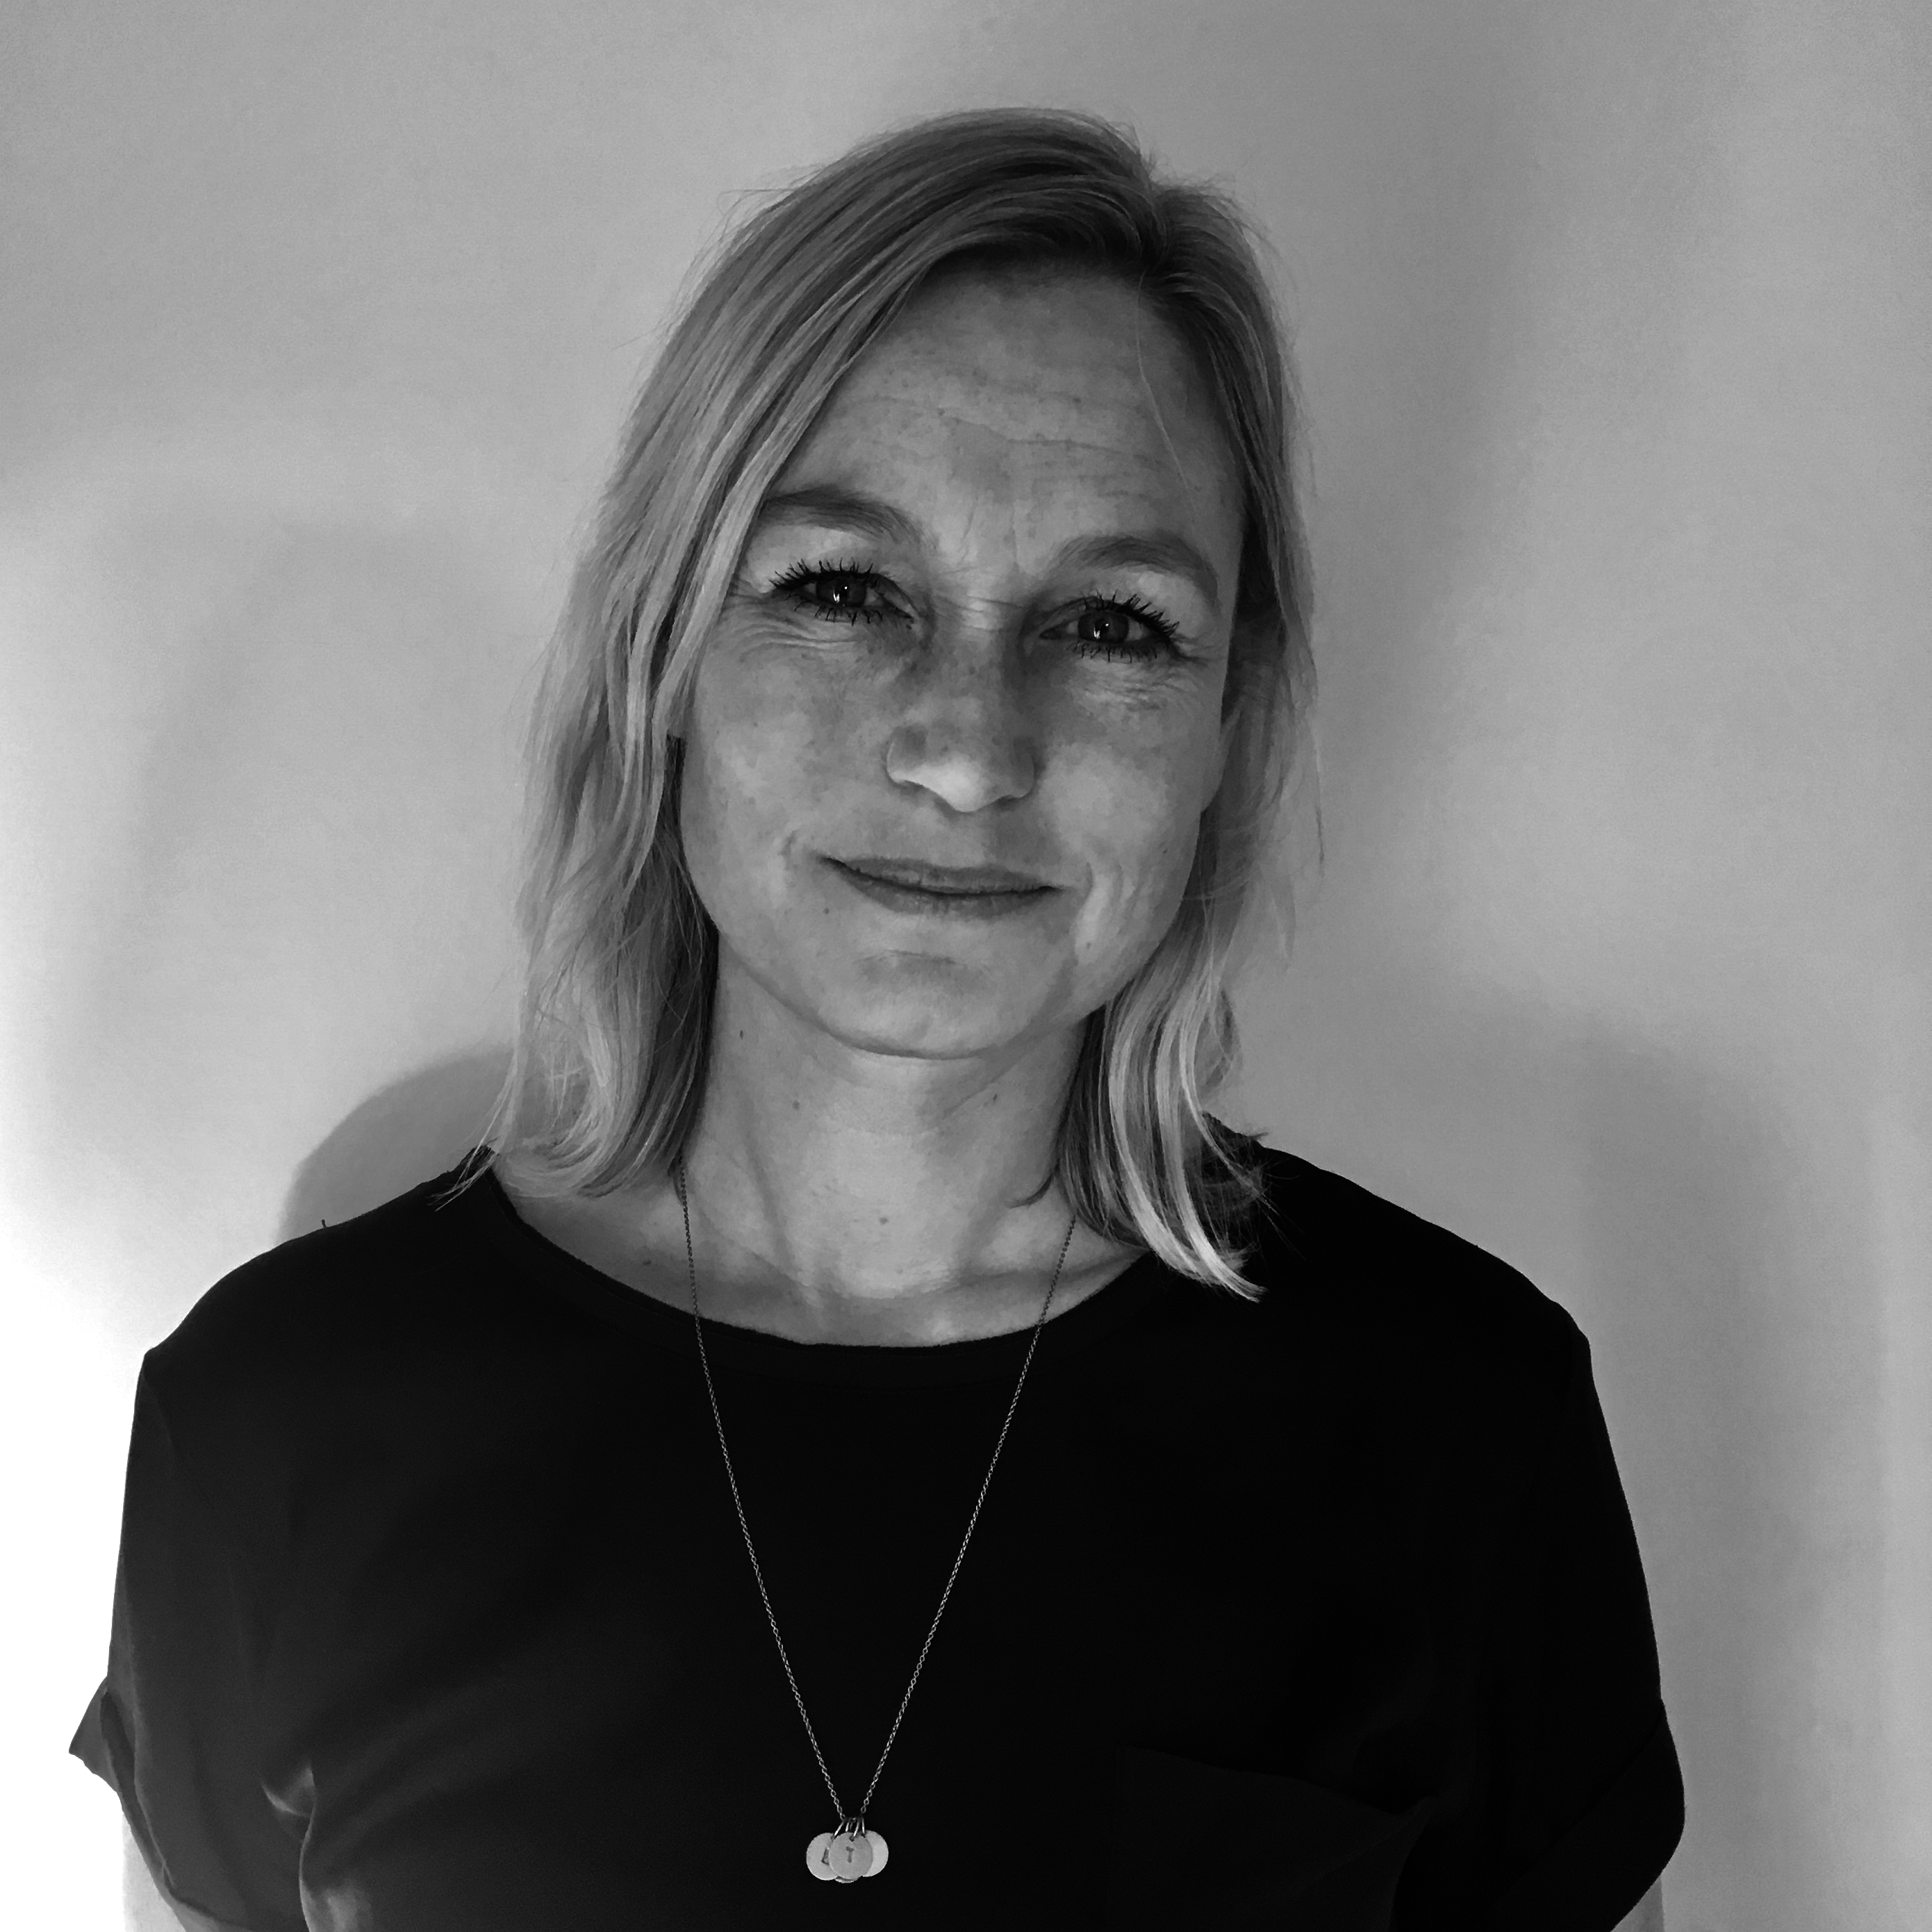
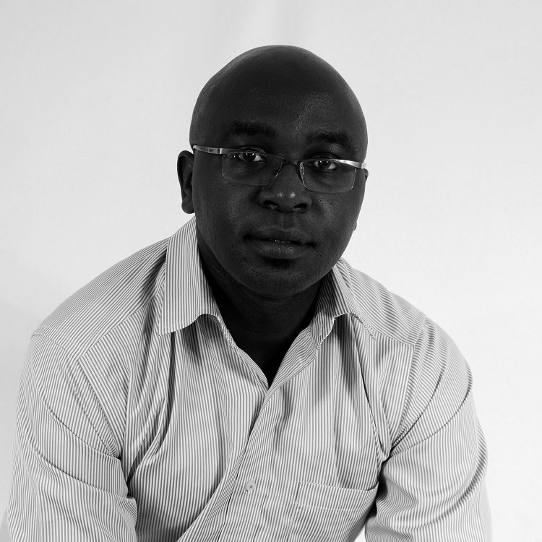
Who
WHO ARE WE - PARTNERS
LISBETH STAUSHOLM ZACHO
HUMPHREY WATTANGA
THIRD PARTNER
FOUNDER/CEO
10 years experience in international development from IMF, WB and NGO
10 years financial experience from
the Danish central bank
Experience in health, education and development programs
Expertise in anticorruption, compliance,
risk and financial management
MSc Economics, MBA
PARTNER/CIO
15 years experience in structuring private equity and impact investment deals in East Africa
Expert in innovative social finance and public private partnerships
Structured social impact bond on early childhood education
Lead advisor in the development of a pioneering government retail bond mobile platform
BSc Harvard, MBA Wharton
PARTNER
Our third partner is currently working for another organization
>15 years experience in investment transactions and project finance in developing countries
+USD 3 billion deal flow – all with positive returns
Long track record from international development banks
Experience from a pension fund as an investor in private equity funds

Slide 5
What
OUR MISSION
MISSION
To improve the quality of life for low-income people in East Africa by capitalizing enterprises that have a scalable and economically viable model for IMPACT
- A dual bottom line of positive societal and financial returns!
>$60/day
High-income
<$60/day
Middle-income
<$5/day
Low-income/subsistence
<$1/day
Extreme poverty

Slide 6


KEY TERMS AND TARGETS
How
TARGET FUND SIZE
Target size EUR 75 million in capital commitments, minimum EUR 50 million
TARGET RETURN
IRR>15% (EUR)
MANAGEMENT FEE
Management fee is 2% p.a. of capital commitments
CARRIED INTEREST
Carried interest is 20% above a preferred return
CSR
20% of carried interest is dedicated to social impact assistance
A new specialist fund investing for
social impact in East Africa

Slide 7










THE OPPORTUNITY
Fastest growing region in the World. Current and projected
real GDP growth rates exceeding 5% in the region. EIU projects Kenya to be 7 times its current size in 2050.
Fairly stable political and macro-economic environments
Ethiopia
Fast growing work force from a combined population of over 250 million of which majority lives for less than 5$ a day
Uganda
Kenya
The low income segment comprises the mass market in East Africa
Rwanda
Broad industry diversification and low dependency on commodities
Tanzania
Improving environment for doing business and investment

Slide 8
GROWING WORKFORCE
IN AN AGING WORLD
BY 2034, AFRICA’S WORKFORCE WILL BE LARGER THAN THAT OF CHINA AND INDIA AT 1.1 BILLION
WORKING-AGE POPULATION IN LARGEST COUNTRIES AND REGIONS
MILLION PEOPLE AGED 15-64
A RISING WORKING-AGE POPULATION SHARE IS POSITIVELY CORRELATED WITH GDP PER CAPITA GROWTH
Source: McKinsey Global Institute, 2016
Source: World Bank Group, 2016

Slide 9







LOW CORRELATION
WITH INTERNATIONAL MARKETS
African markets are weakly correlated with Europe and the US as well as internally amongst other African markets
USA
Europe
MSCI FM
South Africa
Kenya
Nigeria
Rwanda
Tanzania
Uganda
Zambia
Monthly correlation
2014-17
USA
1
Europe
0.665
1
MSCI FM
0.538
0.388
1
South Africa
0.57
0.532
0.686
1
Kenya
0.216
0.275
0.362
0.17
1
Nigeria
0.165
-0.046
0.46
0.189
0.36
1
Rwanda
0.005
0.057
0.259
0.057
0.225
0.161
1
Tanzania
0.055
0.029
0.226
-0.042
0.433
0.009
0.395
1
Uganda
0.074
0.182
0.224
0.126
0.751
0.16
0.252
0.498
1
Zambia
0.117
0.175
0.129
0.054
0.345
0.141
0.233
0.187
0.322
1
Sources: Investment Frontier (2017)

Slide 10
FINANCIAL RETURN
EXPECTED RETURN
IMPACT FUNDS (N=209)
PAST PERFORMANCE
IMPACT FUNDS (N=202)
66% Risk-adjusted market rate returns
18% Close to market rate return
16% Close to capital preservation
Gross return expectations for survey funds were on average 16,5 %
(on equity) and 91% are on or above target
Outperforming
In line
Underperforming
Source: GIIN Impact Investor Survey, 2017

Slide 11
SOLUTIONS
– TRENDS AND CHALLENGES
TRENDS:
Mobile – accessibility, payment, credit, info, communication, USSD
PAYG – Pay-as-you-go
Solar – home solar, off grid, mini grid, on grid …for light, cooling, water pumps, storage, processing, kiosks etc.
Data driven – multiple information sources, uniting fragmented markets, using data to improve productivity, machine learning algorithms
Blockchain – for cross border payments, land rights, identity, legal contracts…
Wallets - digital wallets for education, health, insurance, savings, inputs etc
CHALLENGES:
Need for physical structures, networks, distribution, partners
Many solutions to same problems – who is the winner or is the market big enough? Will some of the solutions be taken over by government?
Many start-ups – few mature businesses

Slide 12

Why
ENEZA EDUCATION
A MOBILE EDUCATION PLATFORM
Eneza Education is a comprehensive virtual tutor, that provides universal access to affordable, quality, lifelong learning through ubiquitous mobile technology. As a social enterprise, Eneza reinvest its resources to educate low income earners at scale, 70% of them living in rural areas
With over 3.2 million unique users, Eneza Education is undoubtedly Africa’s #1 Mobile Learning Platform for 10 – 25-year-old learners in rural Africa
Eneza offers a virtual tutor and teacher’s assistant – a way for both students and teachers to access courses and assessments while interacting with live instructors – all through low-cost mobile phones
Students can access locally-aligned tutorials, tips, and assessments, as well as a leaderboard, Wikipedia text and live teacher chat, an online web app, an offline desktop app, and an Android app
Individual parents, students or teachers can buy a subscription to courses for a low weekly or monthly fee
3.2 million
KE, TZ, GH & CI
Growth
stage
USD 3 million
Education
BUSINESS MODEL
Eneza aims to reach the masses through accessible and affordable products, and is thus considered a “base of the pyramid” business model
All products are extremely low cost for the end user (students, teachers or parents) and range between $1.20-$7.20 a month
Eneza furthermore sells web-based school accounts, SMS data reports and tips for parents and teachers

Slide 13

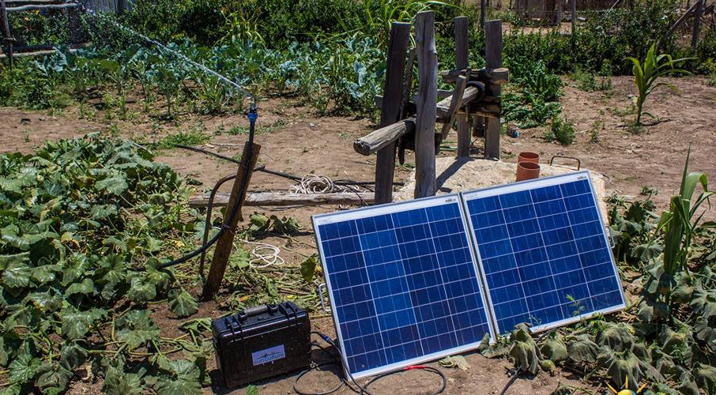
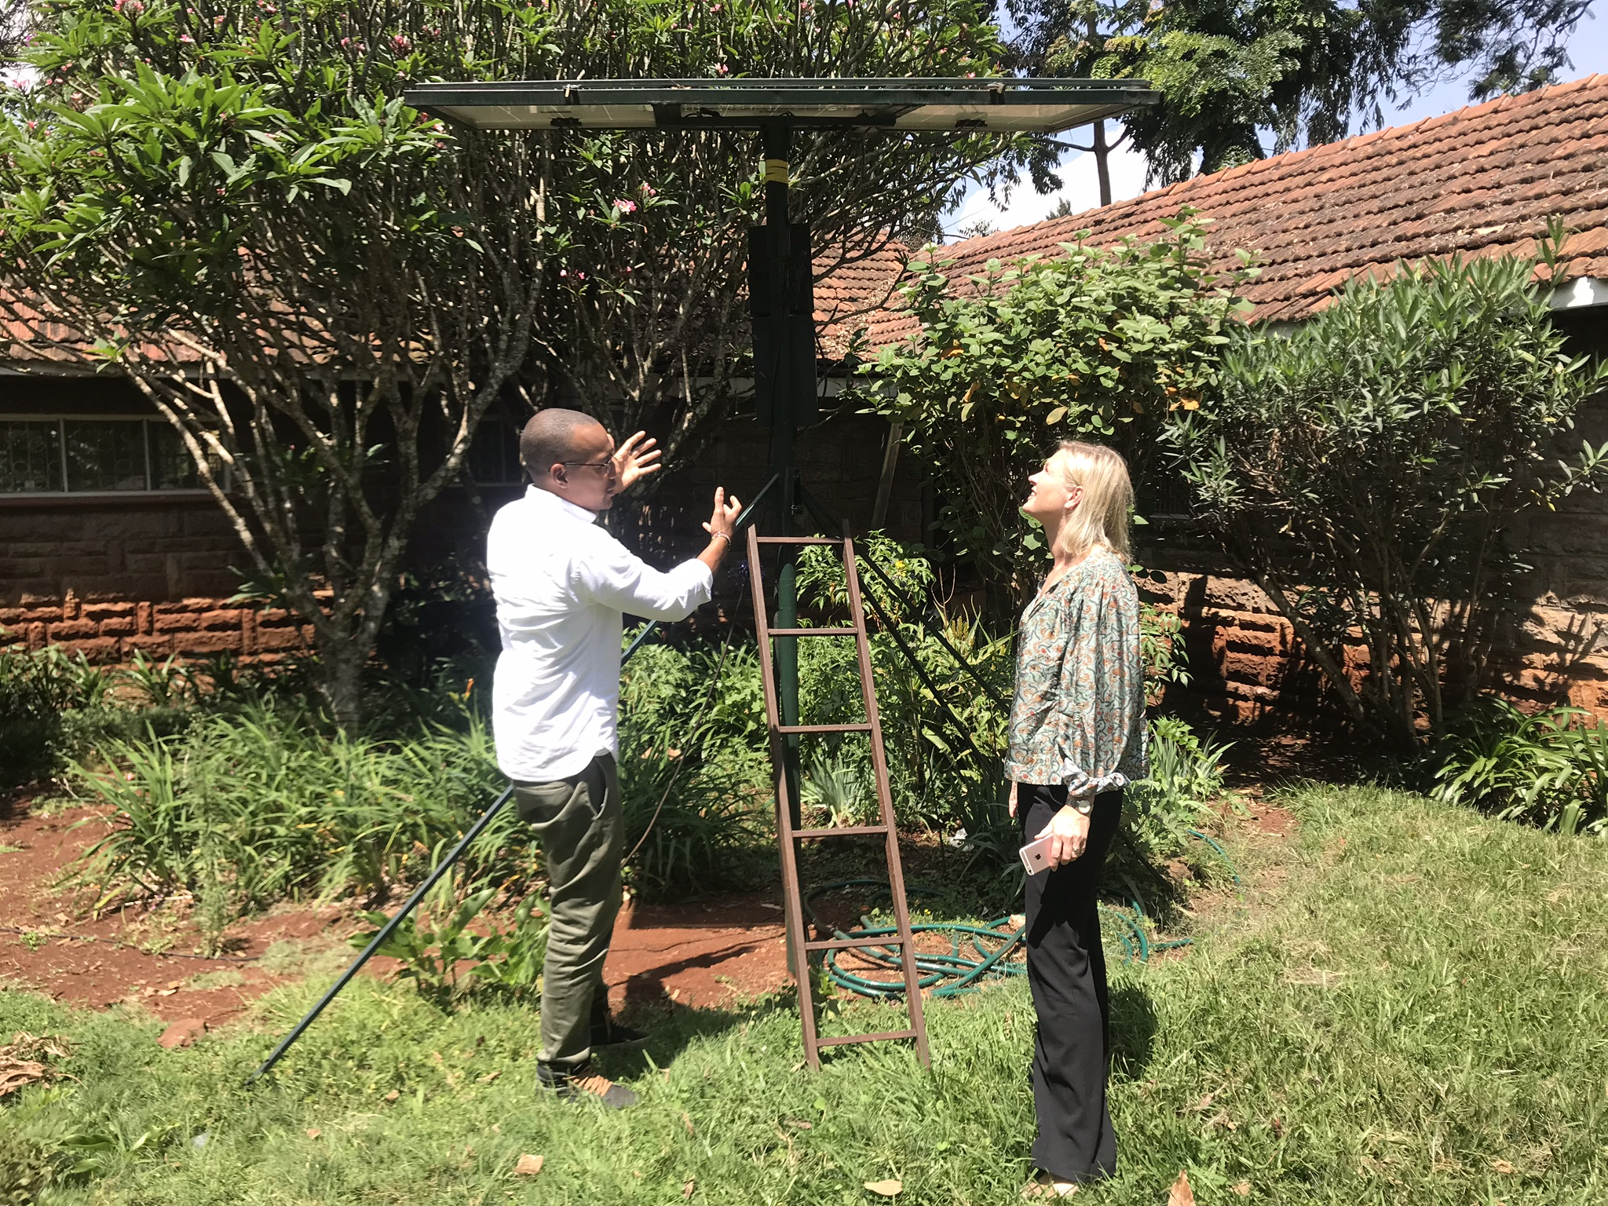

Why
SUNCULTURE
HELPING FARMERS GROW MORE WHILE SPENDING LESS
Combining the energy efficiency of solar power with the effectiveness of drip irrigation
60% of land in Africa is suitable for farming, but only 6% is currently under irrigation, leaving 2 billion acres without irrigation
SunCulture’s RainMaker solar water pump system is a transformative internet connected system designed to help smallholder farmers in underserved communities improve agricultural productivity and profitability
The RainMaker provides a long- lasting, low cost solution in low rainfall. The solar panels provide the pumps’ power directly without the need for expensive batteries or inverters
SunCulture offers a price point low enough that a Kenyan farmer can afford it and can save a farmer over $10,000 per year and using the RainMaker can help boost a farmer’s income to 1.2 million Kenyan Shillings ($11,538) annually compared to less than 300,000 Kenyan Shillings ($2,884) relying on rainfall
Currently, SunCulture has had an impact on >1500 customers across
East Africa
>1500 customers
Kenya
Growth stage
3 m
Agri-business
PRODUCTS
RAINMAKER SYSTEM
Starting from 50,000 KES* for capacity of 7000L of water/day
Developing a “pay as you grow”-solution
DRIP IRRIGATION
Starting from 8,900 KES for a standard 1 Acre Kit
Price dependent on farm layout, design and acreage
MIST IRRIGATION
Starting from 39,000 KES for a standard 1 Acre Kit
Price dependent on farm layout, design and acreage

Slide 14
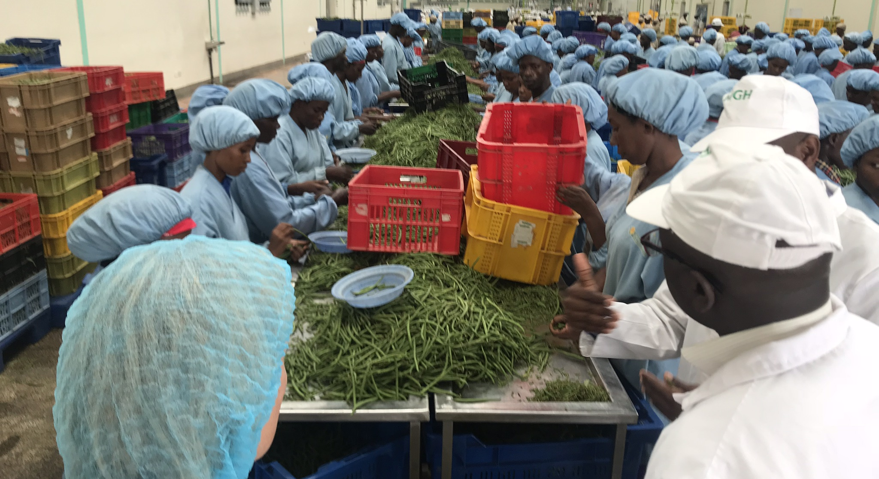

Why
MERU GREENS
EMPOWERING SMALL HOLDER FARMERS – ADDING VALUE LOCALLY
Combining procurement of crops from smallholder farmers with local value addition before exporting ensures gains for local smallholder farmers
Farmers are organized in small groups for the different target crops then trained by a well tailored and result oriented MGH technical extension team
Training entails GAP, adoption to farming technologies through smart agriculture on practical demonstration plots, climate shocks mitigation, conservation of flora and fauna, household nutrition, agri-business, post-harvest handling etc.
Extension method through demonstrations and farm visits disseminate the new farming technologies
Farmers produce is collected from the farms or from a designated collection centre by MGH staff for value addition and then brought to the European market
Mentoring of Suppliers who aggregate from Small Scale farmers is also exercised to bring about growth and employment in the rural regions
40.000 smallholder farmers
Kenya
Growth stage
USD
0.5m – 4m
Agri-business
BUSINESS MODEL
100% SOURCING FROM SMALL HOLDER FARMERS
Meru greens sources crops from 40.000 smallholder farmers, with 12.000 active at any given time
TAKING VALUE ADDITION TO THE FARMERS
Farmers’ produce is collected from the farms or from a designated collection center by MGH staff for value addition
EXPORTING VALUE ADDED PRODUCTS TO EU CONSUMERS
700 women are employed at the factory where the products are fabricated and exported to European supermarkets

Slide 15



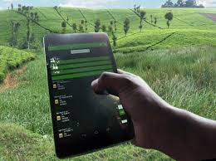
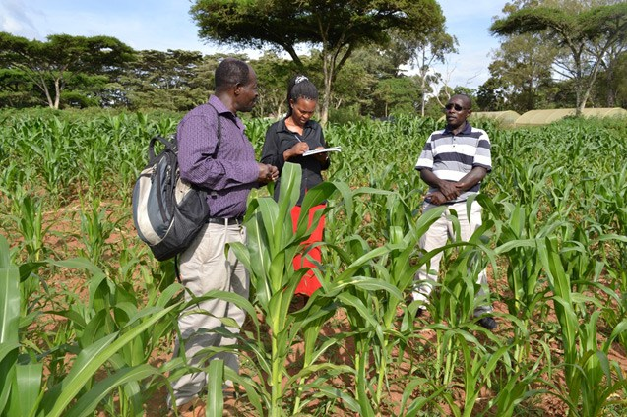


iProcure
RE-INVENTING DISTRIBUTION FOR RURAL AFRICA
AN AGRICULTURAL SUPPLY CHAIN PLATFORM
iProcure is the largest agricultural supply chain platform in rural Africa
In addition to complete procurement and last mile distribution services, iProcure provide business intelligence and data-driven stock management across the supply chain
  DATA-DRIVEN DISTRIBUTION
  Through real-time data, iProcure provides an alternative distribution channel that ensures that the products of smallholder farmers gets all the way to the end consumer
  BUSINESS INTELLIGENCE
  iProcure provides complete supply chain visibility so that smallholder farmers can see who is buying, when and for how much – in real time
  WAREHOUSING
  iProcure’s storage facilities are strategically located to ensure extensive reach to the rural consumer. The company’s predictive algorithms ensure that essential commodities are never in short supply
  LAST MILE
  iProcure’s supply chain platform enables rapid order fulfilment to wherever the customer is
PROBLEM
The market for agricultural inputs in Africa is broken:
Manufacturers lack visibility and reach to the large but diffuse smallholder market
Wholesalers and retailers lack the information and working capital to stock what is needed
Smallholders suffer high prices and sporadic access to the right inputs
SOLUTION
Leveraging a proprietary ERP platform, mobile technology, and its own depots, iProcure operates a demand led, data-driven solution to these problems, connecting input manufacturers directly with smallholder farmers

Slide 16
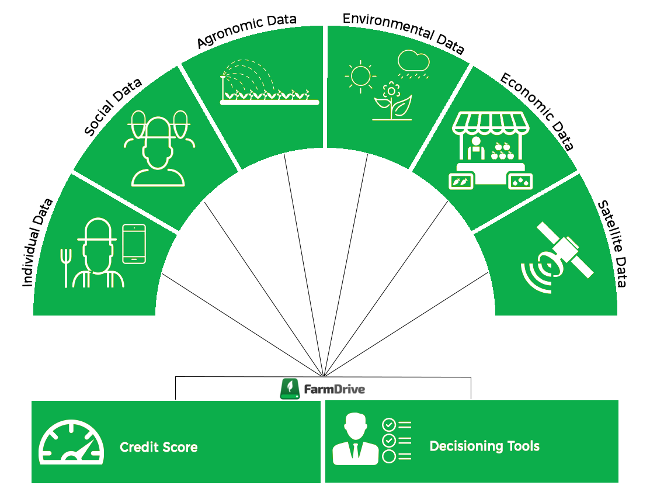



FarmDrive
UNLOCKING ACCESS TO CREDIT FOR SMALLHOLDER FARMERS
SOLUTION
ALTERNATIVE CREDIT SCORING FOR SMALLHOLDER FARMERS
FarmDrive uses mobile phones, alternative data, and machine learning to close the critical data gap that prevents financial institutions from lending to creditworthy smallholder farmers
50 MILLION SMALLHOLDER FARMERS
Nearly 50 million smallholder farmers in Africa are struggling to support their families and communities through agri-business because less than 10% have their economic needs met by the financial sector. Without access to credit, they remain unable to purchase quality inputs, make productive investments, and improve their production and harvests
  $450 BILLION FINANCING GAP
  Agriculture employs 65% of Africa’s population and makes up 32% of its GDP. However, less than 1% of bank lending in Africa goes to agriculture. In absence of accurate and cost-effective methods for assessing small-scale agricultural lending risk, financial institutions choose not to lend to smallholder farmers, thereby contributing to the $450 billion global agriculture financing gap
FarmDrive collects and aggregates alternative datasets from multiple sources, in Kenya and around the world, to build credit scores for smallholder farmers in Africa
The alternative datasets are analysed by a machine learning algorithm to produce relevant credit scores for smallholder farmers, and decisioning tools that enable financial institutions to develop small-scale agriculture loan products

Slide 17
Why
KUKU BORA
KUKU BORA
EMPOWERS SMALL SCALE CHICKEN FARMERS
Kuku Bora is transforming farming of indigenous chicken into a viable economic activity
Social and economic empowerment of over 50,000 small-scale rural households leading to better quality of life. Additional 500 jobs in hatchery, slaughterhouse, boda-boda riders etc.
Increased productivity and access to market – increased survival rate of chicks and guaranteed market
Enabling climate smart benefits through lower carbon emissions, efficient water use and smaller land foot-print required to raise chicken;
Strengthening the cluster/cooperative model of rural agricultural production
Enabling out-grower scheme with mobile payments locking a certain share for re-investments in chicks, feed and vaccine.
Improving product quality and nutrition for the consumer
50,000
farmers
Kenya
Early/mid
stage
USD 2
million
Agri-business
EMPOWER THE FARMER, SATISFY THE CONSUMER!

Slide 18


Why
SANERGY
SANERGY
AFFORDABLE HYGEINIC SANITATION
2.5 billion people lack access to hygienic sanitation - second largest cause of disease in the world.
Sanergy makes hygienic sanitation affordable and accessible throughout Africa’s informal settlements.
Design and manufacture low-cost, high-quality sanitation facilities
Network of Fresh Life Operators – local residents who purchase and operate the hygienic sanitation facilities
Collection of waste on a daily basis
Conversion of the waste at a centralized facility into useful end-products such as organic fertilizer, insect-based animal feed, and renewable energy
50,000
Kenya
Growth stage
USD 5
million
Water/ sanitation

Slide 19
BRIDGE ACADEMIES
Affordable education
Bridge International Academies runs more than 550 kindergartens and schools in Africa at low costs
Bridge has developed a scalable model based on automated administration, digital learning programs, guides and curriculum for teachers
Bridge International Academies 2015 KCPE Results
776 Pupils scored above 300 marks
4 pupils scored above 400 marks
19 academies with a 100% pass rate
76 academies with a 70%+ pass rate
8 Counties with an entire country pass rate of 70% or greater
25 Academies with a mean score of 300+
154 Academies with a mean score of 250+
Mean score of 264 nationwide
The first Bridge International Academy opened in Mukuru Kwa Njenga in 2009. Results were 100% pass rate with a mean score of 329
10 million
East Africa
Growth
stage
?
Education
Business model
The model is based on scale in order to finance research, curriculum development, and technology
On average, parents pay a monthly fee of $6.60 for tuition, which can be paid on a flexible schedule. Fees vary depending on a student’s grade and the location of the school. Parents pay a one-time registration fee
School fees and staff salaries are paid via mobile money
Bridge Academies is fixated on driving down costs at every point of its supply chain
Notes:
Måske vi skal udelade Bridge fra materialet – vi kan evt gemme slide til fonde og personer, der har fokus på uddannelse.

