Slide 1
Dorte Kabell Kabell Konsulting ApS
MOPAN
IDA
København
19 januar 2020

Slide 2
Agenda
What and Who is MOPAN? How does it work? What do we look at? Which organisations have been “MOPANNED”?
What next?

Slide 3
What is MOPAN?
The Multilateral Organisation Performance Assessment Network is a network of 19 member countries with a common interest in assessing the effectiveness of the major organisations they fund.
Australia
Belgium
Canada
Denmark
Finland
France
Germany
Ireland
Italy
Japan
Luxembourg
The Netherlands
Norway Republic of Korea
Sweden
Switzerland
United Arab Emirates
United Kingdom United States

Slide 4
What is MOPAN’s mission?
Enhance accountability
Promote learning
Enhance Accountability
by supporting members in assessing organisational and development effectiveness of multilateral organisations they fund.
by informing strategic engagement and dialogue between and among multilateral organisations and development partners.
Meet members’ accountability needs
Institutional Assessment Reports
31 MOs assessed under MOPAN 3.0
Information for policy / decision-making
Identify and share good practice
Provide impetus for self-improvement for organisations
Provide learning opportunities for donors / members
Modality: Case studies, analyses
Promote Learning

Slide 5
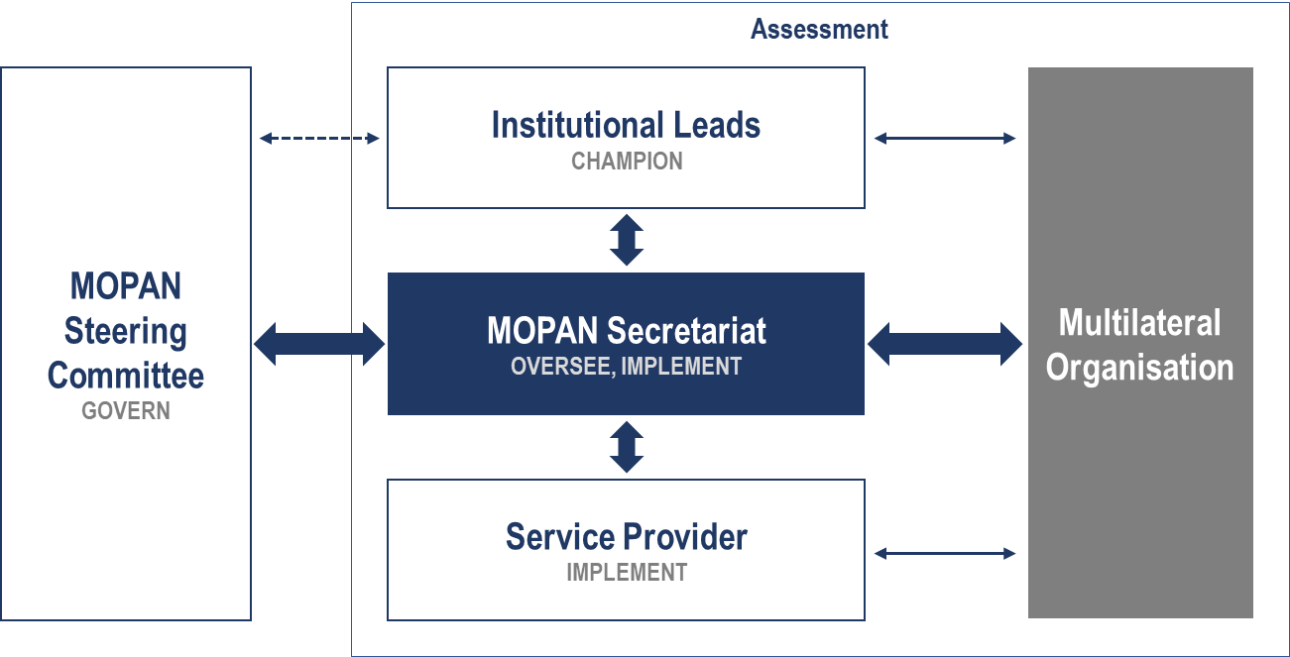
How does MOPAN operate?
MOPAN is an independent entity, with a Secretariat hosted by the OECD

Slide 6
MOPAN 3.0 is built on a key hypothesis
IF a multilateral has effective systems, practices and behaviours in place …
Strategic Management
Performance Management
… THEN its interventions/activities will be more “efficiently delivered”, defined as:
Evidence-based, relevant/appropriate, responding to global normative priorities, efficient, functioning within a coherent partnership, with results reported and accounted for …
… AND HENCE, delivery will achieve relevant, inclusive and sustainable contributions to development and humanitarian results in an efficient way.
Operational Management
Relationship Management

Slide 7
MOPAN 3.0 examines 5 performance areas
ORGANISATIONAL EFFECTIVENESS
RESULTS
Source: MOPAN 3.0 Methodology, 2017-18

Slide 8
MOPAN Methodology: Framing questions
Does the organisation have sufficient understanding of the needs and demands if faces in the present, and may face in the future?
Is the oganisation using its assets and comparative advantages to maximum effect in the present, and is it prepared for the future?
Are the organisation’s systems, planning and operations fit for purpose? Are they geared in terms of operations to deliver on its mandate?
Is the organisation delivering and demonstrating relevant and sustainable results in a cost-efficient way?
Notes:
Analyserer al den date med henlik på at lave et narrative omkring MO I forhold til disse spm – genkende DAC kriterier – relevans – effectiveness – efficiency – impact
Achieving the right approach for any assessment depends on asking the right questions.
The framing/overarching questions behind the MOPAN assessment – which loosely adhere to the OECD DAC criteria for evaluation – are the following:

Slide 9
A MOPAN 3.0 assessment is a structured process

Slide 10
A one year cycle
Notes:
.

Slide 11
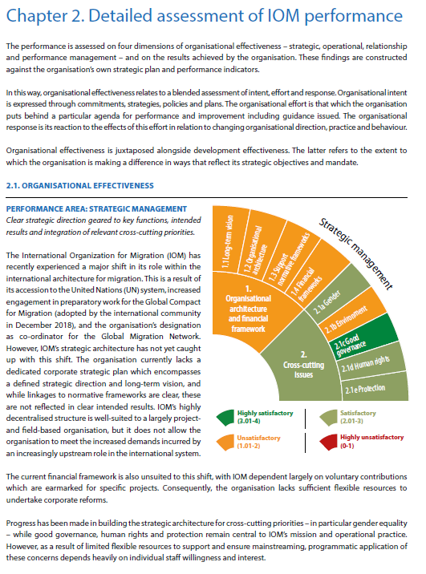
Assessments and Analytical products
Assessments Cycles
Case studies
2015-16
AfDB
2017-18
AsDB
2019
CGIAR
GAVI
Global Fund
IDB
ILO
UN Habitat
UNAIDS
UNDP
UNEP
UNICEF
UNOCHA
World Bank
FAO
GEF
GPE
IFAD
IOM
OHCHR
UNESCO
UNFPA
UNHCR
UNRWA
UN WOMEN
WFP
WHO
MLF
UNCTAD
UNIDO
UNODC
Collaboration FAO/IFAD/WFP
2030 Agenda
UN Reform
Sexual Exploitation, Abuse and Harassment
Review of MOPAN’s results framework
Differentiating MOPAN’s approach
Notes:
Ikke spørge hvordna valgt – 209 bizar – måske bruge på nye såsom AIID – 1-8 kun ikke results

Slide 12
MOPAN has progressed in the past 5 years
Major methodological leap forward – robustness, evidence base and results, quality
Coverage of multilateral system massively increased – 31 organisations over five years
Case studies
Enhanced external visibility & credibility
Use by members enhanced through engagement, more accessible products

Slide 13
Thank you
Questions?

