Slide 1
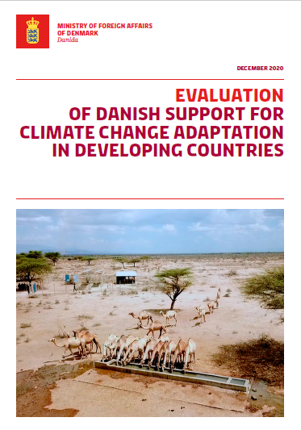
Evaluation of the Danish Support for Climate Change Adaptation in Developing Countries
23 February 2021
Final report dissemination
PEM – ODI

Slide 2
Purpose, scope, questions for evaluation of the Danish support for climate change adaptation in developing countries
Purpose
The overall theme of the evaluation is to examine how and to what extent the Danish development aid portfolio is addressing longer-term climate resilience in target countries, and to identify mechanisms that have been successful in this respect.
Scope
Four areas of inquiry:
The role of the Climate Envelope (CE) within the overall adaptation portfolio
Mainstreaming climate considerations into bilateral Danish ODA
Transformative responses to climate change
Denmark’s role in the international climate change adaptation (CCA) support landscape
    The period covered is 2008-2018 – drawing on earlier work for 2008-2012
    Field countries: Bangladesh (done); Ethiopia/ Kenya/Burkina Faso-Niger(done)
    25 interventions sampled
Covid -19
Covid-19 led to 2 country notes being drafted on desk basis – Kenya/Ethiopia
Questions
MAINSTREAMING
RESILIENCE
TRANSFORMATION
EQ 1: Mainstreaming approaches: How relevant and effective were approaches to mainstreaming across the Danida portfolio?
EQ 3: Spearhead CCA intervention areas: To what extent did the Danish support contribute to putting in place the key building blocks required to address CCA?
EQ 5: Transformative approaches: How does the Danish CCA approach to planning, design and project implementation work to advance transformational change?
EQ 2: Mainstreaming results: What are the implementation outcomes of CCA mainstreaming?
EQ 4: Spearhead direct outcomes and impact of climate change adaptation projects: Has the resilience of poor and vulnerable people increased?
EQ 6: Transformative outcomes:
To what extent has support for CCA contributed to transformative responses to climate change?
GLOBAL LANDSCAPE
EQ 7: Global results: Has the Danish engagement contributed to global discussions on support to CCA in developing countries?
EQ 8: Global strategic approach: What were the factors that led to influence or lack of influence?
EQ 9: Global Institutional learning: Has institutional learning taken place within Danida on CCA that could support Danish input to the global adaptation and development agenda?

Slide 3
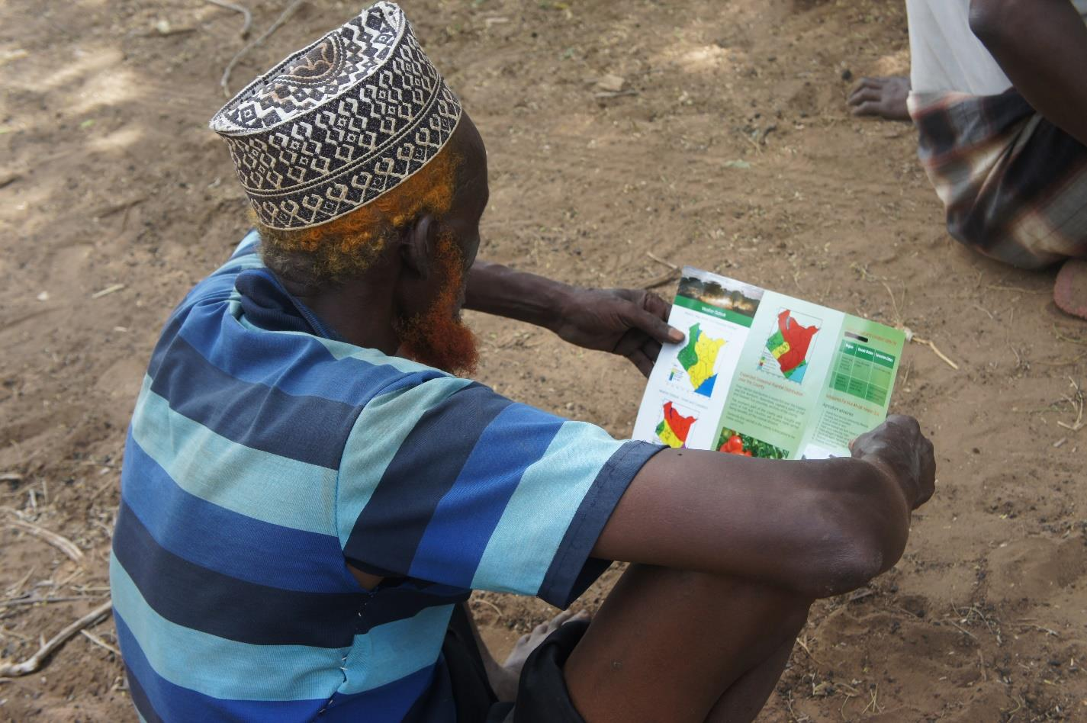
Main messages and conclusions – policy context and mainstreaming
Fluctuating Danish policy priorities resulted in weakening strategic focus
Limited guidance and knowledge, given the complexity of climate change adaptation
Mainstreaming results have been patchy and focused on policy and planning
Strong policy signals on mitigation and green economy less so on adaptation
Climate change adaptation is complex, subject to uncertainty and its specific challenges are often insufficiently understood.
Together this weakened and complicated efforts to both mainstream and engage directly in climate change adaptation.
Danish engagement supported increasing partner country commitment to mainstreaming climate change adaptation.
But with stronger results in planning and budgeting than in implementation and monitoring
Leaving gaps between policy and practice

Slide 4
Main messages and conclusions – resilience and climate envelope
Danish support enhanced the resilience of poor and vulnerable people
The Climate Envelope did not reach its potential for innovation
The community-level interventions were in general effective at targeting and empowering vulnerable people and led to increased livelihood resilience
Still too early to conclude on sustainability but prospects look promising
Underlying factors that were found influential:
      a focus on community empowerment, capacities, institutions and participation in decision making;
      engagement with key actors at the subnational level, including local governments;
      facilitation of dialogue and cooperation among different stakeholders in the public and private sector;
      linking to livelihoods and income streams and;
      engaging in ecosystem-based approaches and natural resource management.
      The level of innovation and the degree to which interventions were specific to climate change adaptation was low even for the climate envelope projects.

Slide 5
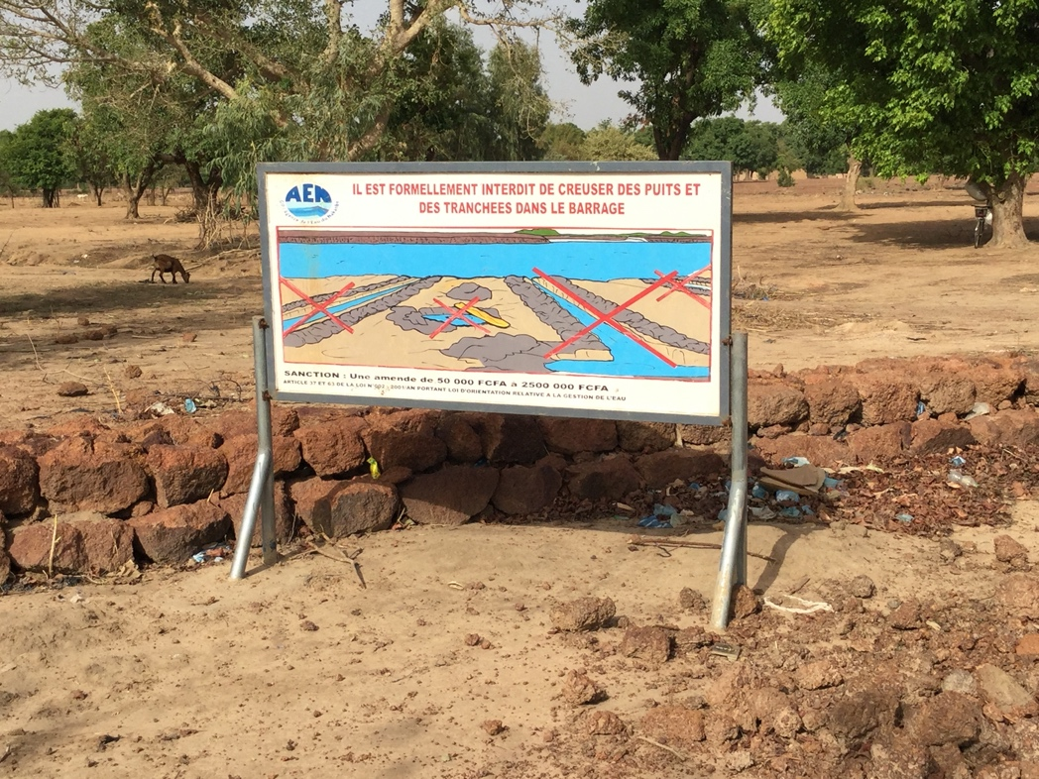
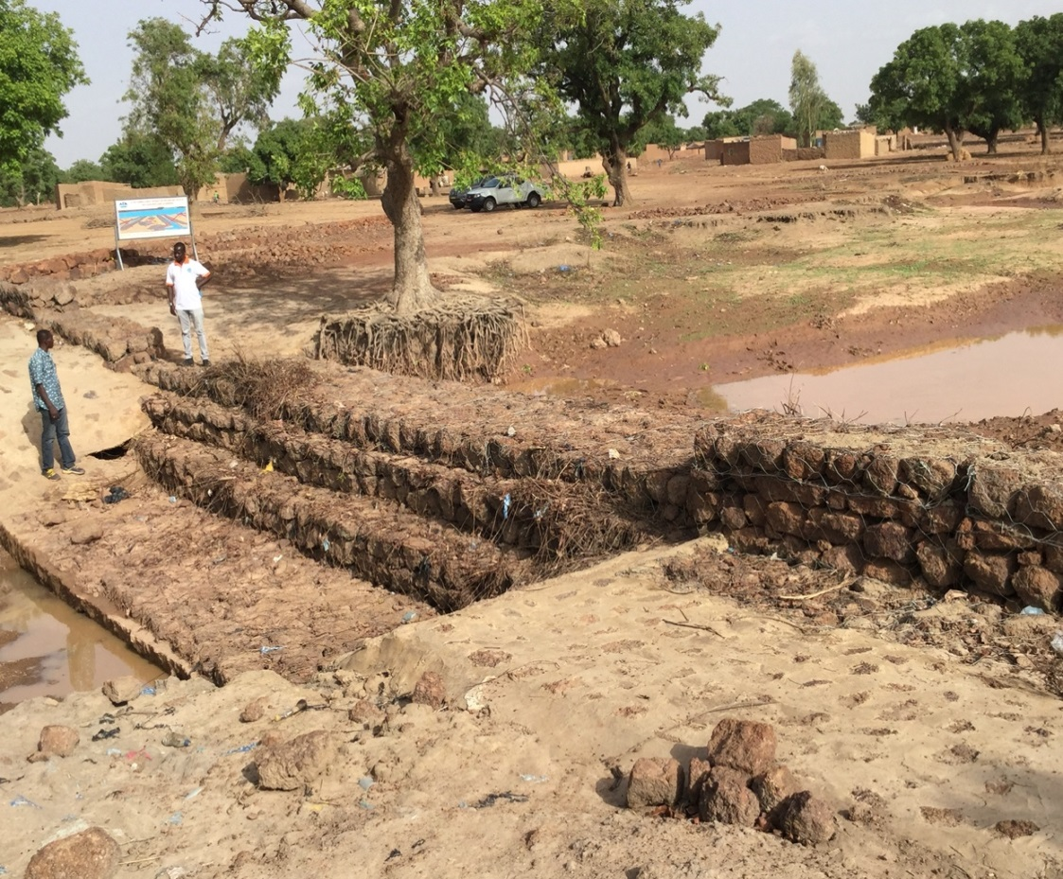
Main messages and conclusions - transformation
Transformation proved to be a highly ambitious goal
Securing sustainability has been the weakest element in promotion of transformation
Making a significant contribution to transformation dependent on committed national and local leadership in partner countries
The scale of the needs is proving challenging to achieve with the resources available to Denmark
The most promising potential for transformation is a programmatic approach has been adopted that responds to national incentives.
However, the sustainability of many such initiatives is often still in doubt without continuing external assistance.

Slide 6
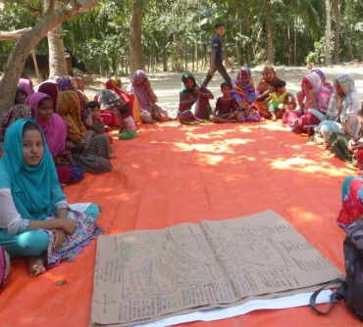
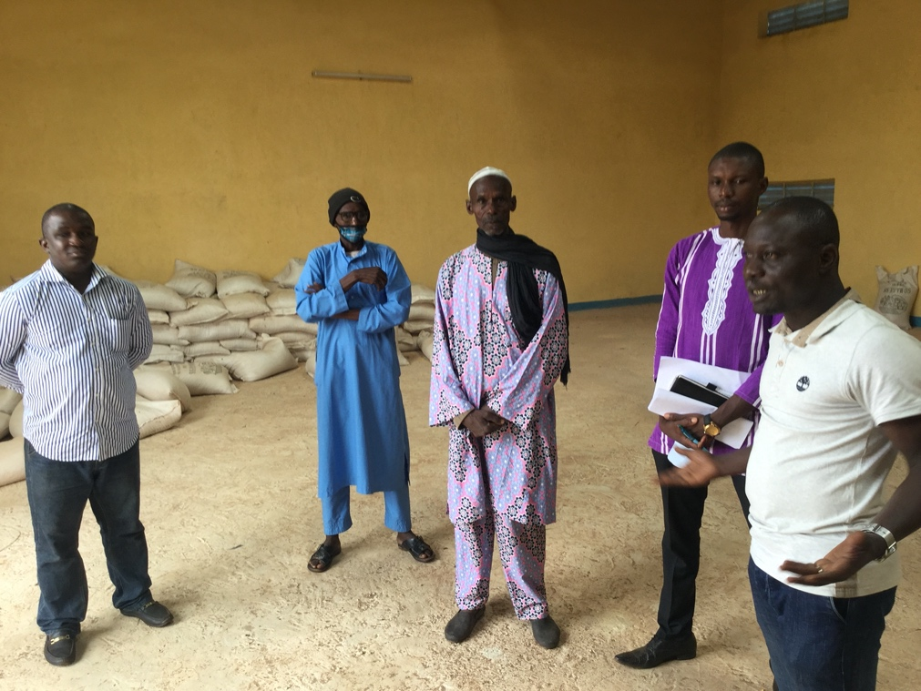
Main messages and conclusions – global landscape
Denmark contributed to the global landscape …
…but the internal learning and experience exchange was weak
Danish public and private sector skills were mobilised but more for mitigation than adaptation.
Danish engagement with the global landscape has demonstrated influence on the multi-lateral interventions that it contributes to – % of climate co-benefits/M&E
There has been relatively little learning within Danida due to missing mechanisms for sharing and resource constraints.
Danish capacity and readiness to influence the global adaptation and development agenda, although threatened by dwindling resources, shows potential through mobilising Danish research as well as experience within the public and private sectors.

Slide 7
Main messages and conclusions - modalities
 | Advantages | Disadvantages
Climate Envelope | The principles provided strategic guidance -2016 Has demonstrated potential for innovation Able to support at regional and global level Started new partnerships beyond bilateral funding Has built on bilateral analysis and partnerships | Tends to lead to a project approach Envelope principles not fully adhered to in practice Institutional mitigation bias Did not draw on Danish adaptation skills Difficult to mobilise added value potential
Using a mix of modalities enabled Denmark to engage at different levels although the potential was not fully used
Bilateral funding | Enables a comparatively large-scale / long term engagement Danida is a major donor in some countries Direct partnerships with governments Mainstreaming opportunity Sound analysis and understanding of country context | Danida a relatively small player in large countries Limited embassy capacity to promote mainstreaming Business as usual tendency Peer learning between countries limited Regional / ecosystem approaches difficult Demand /awareness dependent
Multi-lateral funding | Voice and convening power Accesses technical and management expertise Strong fiduciary systems Easy to oversee/manage – minimises MFA resource requirement Regional and global programming possible | Heavy and slow bureaucracy Sometimes politicised Less Danish visibility and influence on individual interventions Often in practice, only weak links to embassies and Danish experiences
NGO funding | Empowerment of people with clear link to poverty reduction and resilience of vulnerable groups Strong on advocacy and citizen engagement Technical and management expertise Linking local-national-regional-global levels Peer learning and replication (within the NGOs) | Ensuring government ownership more difficult Donor dependency Limited financial capacity of partners to ensure post-intervention sustainability Often small scale and difficult to replicate without additional projects.

Slide 8
Recommendations
Develop a long-term and realistic ambition for increasing Denmark’s contribution to climate change adaptation at global, regional and country level.
Make greater strategic use of the Climate Envelope for interventions that are highly additional or would not otherwise be undertaken by normal bilateral support.
Gain greater clarity over what climate change adaptation is and how Danish development cooperation can best support both mainstreaming and transformation.
Seek opportunities to reduce uncertainties through enhancing climate-related knowledge, information and planning routines.
Adopt a programmatic approach that is informed by the political economy context of each partner country when aiming to contribute to transformation.
Develop internal sharing mechanisms and enhance the learning from and contribution to the global landscape.

Slide 9
Main messages and recommendations
MAIN MESSAGES
RECOMMENDATIONS
Develop a long-term and realistic ambition for increasing Denmark’s contribution to climate change adaptation at global, regional and country level.
Make greater strategic use of the Climate Envelope for interventions that are highly additional or would not otherwise be undertaken by normal bilateral support.
Gain greater clarity over what climate change adaptation is and how Danish development cooperation can best support both mainstreaming and transformation.
Seek opportunities to reduce uncertainties through enhancing climate-related knowledge, information and planning routines.
Adopt a programmatic approach that is informed by the political economy context of each partner country when aiming to contribute to transformation.
Develop internal sharing mechanisms and enhance the learning from and contribution to the global landscape.
Fluctuating Danish policy priorities resulted in weakening strategic focus
Limited guidance and knowledge given the complexity of addressing climate change adaptation
Mainstreaming results have been patchy and focused on policy and planning
The Climate Envelope did not reach its potential for innovation
Danish support enhanced the resilience of poor and vulnerable people
Transformation proved to be a highly ambitious goal
Securing sustainability has been the weakest element in promotion of transformation
Denmark contributed to the global landscape …
…but the internal learning and experience exchange was weak
Danish public and private sector skills were mobilised but more for mitigation than adaptation.
Using a mix of modalities enabled Denmark to engage at different levels although the potential was not fully used

Slide 10
Recommendations and measures
R1
Develop a long-term and realistic ambition for increasing Denmark’s contribution to climate change adaptation at global, regional and country level.
Rationale:
Contributes to SDGs and Paris Agreement relevant
Contributes to sustaining poverty reduction advance and countering the trend towards inequality and ecosystem degradation
Transformation is demanding but new opportunities (Covid 19+) to transition to a greener future.
Recent whole-of-government climate strategy (2020) provides a springboard.
Measures to implement the recommendation
Prioritise and develop an evidence base for where Denmark has most to offer within climate change adaptation in terms of technical expertise and demonstration, peer to peer public sector cooperation and climate diplomacy.
Set out a realistic ambition for Denmark’s contribution country by country – where Denmark, led by national partners and working with international actors, can increase its contribution to, at a country level in the current and next generation of country strategies.
Enhance climate diplomacy and increasing the focus on climate change adaptation as part of a green transition
Notes:
P51

Slide 11
Recommendations and measures
R2
Make greater strategic use of the Climate Envelope for interventions that are highly additional or would not otherwise be undertaken by normal bilateral support.
Rationale:
Climate Envelope was not used in a systematic manner
Tools and approaches missing
Moreover, there was limited synergy and cross-fertilisation between support under the different modalities.
Danish climate change adaptation expertise, capacities and solutions were also not mobilised significantly.
Measures to implement the recommendation
Identify opportunities to catalyse mainstreaming of climate change adaptation in the bilateral programme.
Engage with a long-term horizon beyond the normal 5-year development planning, including addressing regional and transboundary adaptation challenges and promoting ecosystem-based approaches.
Mobilise the climate change adaptation technical skills and expertise of the Ministry of Environment and Food and other Danish public and private entities
Support a help desk function to assist embassies and implementing partners in understanding and integrating climate change adaptation in a more robust and focused manner.
Create and take part in opportunities for linking bilateral, multilateral and NGO partners in peer learning, experience sharing, coordination and provision of technical inputs.

Slide 12
Recommendations and measures
R3
Gain greater clarity over what climate change adaptation is and how Danish development cooperation can best support both mainstreaming and transformation.
Measures to implement the recommendation
Develop climate change adaptation transformation oriented strategic guidance especially on scale, systemic change and sustainability, and clarify the expected contribution of mainstreaming approaches and objectives.
Dedicate investments to addressing specific sectoral or thematic gaps: climate change adaptation mainstreaming into peace and security orientated interventions, climate change adaptation mainstreaming into private-sector orientated interventions as well as core sectors such as agriculture
Prioritise contribution to addressing climate change adaptation transformation and mainstreaming assessment gaps and make use of international experience on monitoring of climate change adaptation for that purpose.
Rationale:
Stronger CCA strategic orientations are needed. Addressing the lack of clarity over what CCA is.
How to support transformational change towards a climate resilient economy is not reflected in any strategic or operational guidance
There is limited clarity about the roles and remits of mainstreaming and targeted CCA approaches to contribute to transformation objectives.

Slide 13
Recommendations and measures
R4
Seek opportunities to reduce uncertainties through enhancing climate-related knowledge, information and planning routines
Rationale:
The complexity and uncertainty of CCA are major challenges for ensuring effective adaptation.
As evidenced by ALP and the LDCF-funded project in Ethiopia, better climate and weather information is effective.
Denmark has considerable expertise in weather forecasting, climate modelling and planning tools for adaptation investments.
Measures to implement the recommendation
Promote cooperation between Danish and partner country authorities, especially in delivering and developing climate information at the sub-national level.
Promote transfer of Danish technology with a particular emphasis on identifying appropriate and feasible technologies and tailoring them to the specific national and local contexts of the partner countries.

Slide 14
Recommendations and measures
R5
Adopt a programmatic approach that is informed by the political economy context of each partner country when aiming to contribute to transformation
Rationale:
Greater potential for working with others- especially where the Danish representation does not have the resources to lead
Stronger engagement with key actors at the sub-national level, including civil society, the private sector and local government is needed to complement and bridge the gap between national policy and implementation.
Measures to implement the recommendation
Ensure that Danish Country Programmes, as the main vehicle to securing a programmatic approach, are prepared in full knowledge of the Guiding Principles of the Climate Envelope, which emphasises transformation as a principle of project effectiveness.
Strengthen collaboration with bilateral and multilateral partners in-country that are leading climate change adaptation initiatives with national and local governments.
Develop specific guidance on how programme and projects can contribute to the goal of transformation.
Ensure embassy staff are capacitated to contribute effectively in national forums on climate change.

Slide 15
Recommendations and measures
R6
Develop internal sharing mechanisms and enhance the learning from and contribution to the global landscape.
Rationale:
Although Denmark has had some influence in the global landscape, it has not contributed as fully as it could.
The research capacities as well as public and private sector expertise not yet fully mobilised
No clear channel for experience from the bilateral programmes to influence the global level discussions.
Missing mechanism for information exchange and sharing on the engagement with the global landscape.
Without greater resources – prioritisation is essential.
Measures to implement the recommendation
Mobilise the Danish public and private sector experience and skill set within climate change adaptation (urban planning/sustainable drainage; coastal zone management/weather information and modelling including flood)
Work closely with others to develop common agenda to share the burden of engaging with the global landscape.
Reduce the number of organisations and initiatives that Denmark engages with in order to concentrate resources.
Increase the human and other resources devoted to climate change adaptation policy, research and influence.

Slide 16
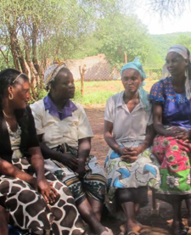
Summary of learning across the evaluation
Working through civil society partners with a presence on the ground has built the resilience of highly marginalised groups, but without wider system change (including integration in government budgets) the gains are threatened.
Factors that led to higher levels of resilience and likely sustainability have been identified and include: building on local strategies for coping ; focus on community empowerment and participation in decision-making; engagement with key actors at the sub-national level, including community-based organisations; facilitation of dialogue and cooperation among different stakeholders and; linking CCA with livelihoods and income streams.
It has not been easy within the bilateral cooperation to contribute to the resilience linked to long-term protection of ecosystems - especially those that are transboundary or reginal in nature.
Climate change resilience

Slide 17
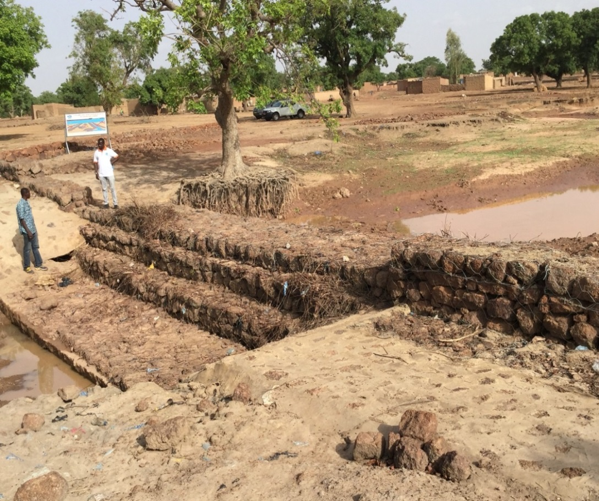
Summary of learning across the evaluation
Bilateral sector programmes offer an opportunity to mainstream CCA within but also beyond the traditionally considered sectors – especially as these programmes are financed over a 5 to 20-year horizon, often multi-donor in nature and benefit from close and trusting relationships built over many years. In many, but not all cases, this opportunity has been overlooked.
Overcoming the implementation barriers to mainstreaming is a priority as policies are often in place but not implemented. In most sectors and in the support provided for mainstreaming CCA there is a significant gap between policy and practice.
Embassies and bilateral missions themselves often do not have the skill set and resources to effectively mainstream or contribute to CCA, at least not optimally – something more is needed from headquarters.
Mainstreaming

Slide 18
Summary of learning across the evaluation
CCA transformation is only rarely framed as an explicit objective and often without an assessment on whether and if so how international cooperation can contribute – this implies a strong diagnostic understanding of the challenges and opportunities, including an assessment of whether the process is genuinely partner initiated and led.
So far project-based cooperation has recorded most progress at community and local government level but only rarely is this joined up at all levels. Sustainable change and transformation demands public sector policy and system change as well as changes within the private sector and civil society in values, behaviour and awareness.
The political economy and scale are key factors that influence the realistic level of CCA transformation that can be achieved. Both imply a high degree of alignment with country actors and harmonisation with other development partners – this is difficult to achieve, if you go alone.
Transformation

Slide 19
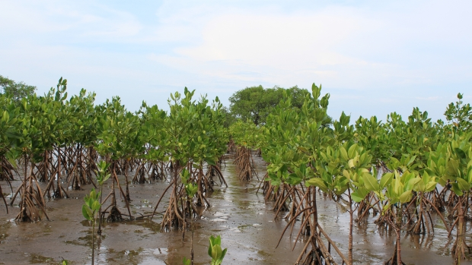
Summary of learning across the evaluation
CCA is complex, highly situation specific, long-term and challenged by uncertainty – improvements in the information environment are a trigger for change.
As effective CCA is influenced by many of the same factors as wider development it has not been easy to identify highly specific CCA interventions that are distinct from normal development cooperation.
CCA is particularly well suited to bilateral programming as it is highly situation specific and can potentially contribute to awareness raising, the information environment and to longer term investments and decision making.
Climate change envelope

Slide 20

Summary of learning across the evaluation
The impact on the global landscape has the greatest effect when working with likeminded countries to influence more sceptical and less likeminded countries, both in the developing and developed countries.
Working with the global landscape and through multi-lateral organisations holds out greater prospects of transformation at country level that reaches all levels because of the scale of resources needed, the need for harmonised efforts and the degree of influence and advocacy required
Both learning from and contributing to the global landscape in a systematic way is demanding for bilateral development agencies with limited resources – greater concentration perhaps through an agreed “division of labour” approach could be relevant.
Global landscape

Slide 21

Targeted climate change adaptation action – findings
Denmark reduced its engagement in climate change assistance at a time where the international community increased its ambitions and commitments.
Adaptation was in particular funded through bilateral financing, the Climate Envelope focused more on mitigation.
The extent to which a robust approach to climate change adaptation was applied varied significantly, even for the Climate Envelope – with little guidance from Danida, this depended on the individual implementing partner’s interests and capacities
The nature of the adaptation engagement varied significantly among the countries in response to the particular context and national priorities, but also as a result of Denmark’s historic engagement and existing partnerships
A significant proportion of the Danish adaptation engagement was implemented outside the normal government system.
The community-level interventions were in general effective at targeting and empowering vulnerable people.
Community empowerment and engagement at the sub-national level were key factors for success.
“ we think of climate variation as a “dry or wet run” for climate change – so if you can internalise how to respond to climate variation then you will be better place to deal with climate change”. Kenya
Degree of climate change adaptation specificity of sample interventions

Slide 22
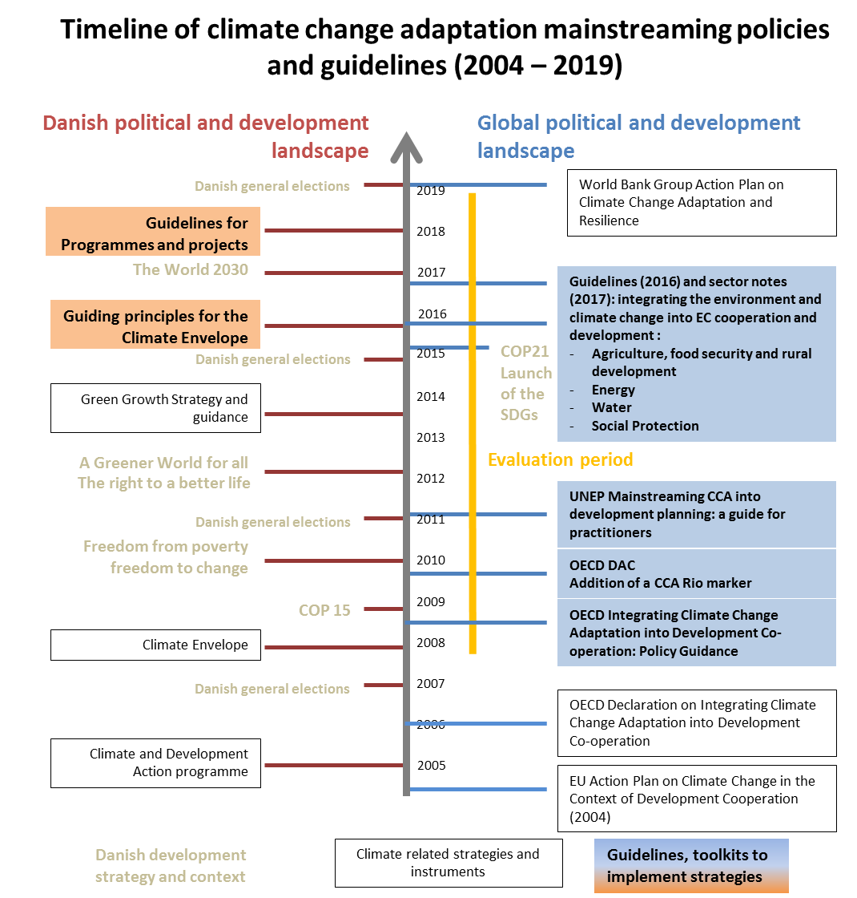
Mainstreaming – findings
Relevance of approaches to CCA mainstreaming
Danish priority to support climate change adaptation fluctuated, climate change adaptation mainstreaming was not part of overall or sectoral strategic guidance, and earlier operational guidance fell out of use.
Mainstreaming of climate change adaptation into non climate-specific interventions was generally prioritised in the highly climate sensitive sectors of water, agriculture and natural resources.
Mainstreaming of climate change adaptation through primarily private sector-oriented interventions was more challenging, including in the agriculture sector.
Mainstreaming of climate change adaptation was not prioritised in sectors such as human rights, governance, peacebuilding and security.
Implementation of approaches to CCA mainstreaming
As a result of limited strategic guidance, few interventions adopted climate change adaptation mainstreaming as a primary objective, and Danida support to climate change adaptation mainstreaming was driven by partners’ strengths and priorities.
Danish engagement did not prioritise nor significantly contribute to mainstreaming climate change adaptation in monitoring systems.
CCA mainstreaming outcomes
Danish engagement contributed to increasing partner countries’ commitment to mainstreaming climate change adaptation and to enhanced planning and budgeting processes.
The gap between policy and practice remains wide: implementation of climate change adaptation mainstreaming into national and local investments was limited by institutional, capacity, and political constraints.

Slide 23
Transformation – findings
Attention to securing transformational change towards a climate resilient economy is a recent emphasis in Denmark’s international support for climate change adaptation.
The opportunity to support transformation towards climate resilience in a partner country is heavily conditional on the local and national context, and ultimately is politically determined.
Securing strengthened climate resilience of those beyond the direct project beneficiaries has not been an explicit goal of most Danish development cooperation projects in the countries sampled, although elements of transformational intent are present in several interventions (and in the 2016 theory of change for the Climate Envelope).
The alignment principle of the aid effectiveness agenda is being respected in Denmark’s support for climate change adaptation and is an early enabling condition that increases the potential for transformation.
Consideration over how to design for the sustainability of investments in the context of climate change is the weakest dimension of transformational change in the project sample across all countries.
Interventions that have aimed to adopt a programmatic approach that includes multiple stakeholders from the design stage onwards appears to be a promising strategy for contributing to transformation.
Some apparent ‘stand-out’ interventions have been identified where the prospects for transformation appear promising and offer potential for broader lesson learning
“The project’s overall legacy for ActionAid has been very significant. It led, in large part, to the global federation of country chapters that make up ActionAid adopting climate change as a global priority. The Danida project in Bangladesh made the case for this global strategy, that ActionAid continues to work towards. This history is largely forgotten as the people involved have moved on” - Bangladesh
Locating a climate change unit in the office of the Prime Minister was done to raise the profile of climate change like it was done for Aids in order to get it mainstreamed – the attention and support we got from government ministries and throughout the country was good – the convening power was a key factor” - Kenya
23

Slide 24
Global landscape – findings – focus on IDA
Denmark’s contribution
Denmark’s engagement with the global landscape was based on a clear and well-documented policy dialogue agenda.
The policy agenda was well-founded.
There is evidence of influence in the WBG across all the main policy agenda points and a key target on climate co-benefits was exceeded.
Denmark strongly exerted influence in the GCF through its strong support to the implementation of the GCF Indigenous Peoples’ policy.
Although the policy agenda was not new for the World Bank or the GCF and LDCF at an operational level, the main value added, particularly for the World Bank support, was the influence on other member countries, both borrowers and funders.
“Those that say Denmark was preaching to the converted have not understood, even if there is consensus with the climate team; there is no consensus on climate change issues at the board of directors. There are many influential countries that question whether the WBG should be engaging with climate change as strongly as they are. If it was not for the strong and well informed [Nordic office and other constituencies] then we would not have been able to make the climate change commitments that we have made publicly –this is the added value and it is more and more important, especially now “–WBG (Director)
Strategic approach
The Danish engagement was timely and used appropriate entry points that coincided with key processes at the UNFCCC and within the WBG, LDCF and GCF.
Close coordination with other funders and borrowers was an important aspect of ensuring influence.
There are a range of factors behind the positive influence both within WBG and the international funds supported. Senior WBG staff in particular emphasise the importance of the development of trust at the operational level and the mobilisation of political capital to influence other board members.
There are inevitable trade-offs in the strategic approach to influencing change. These include: the level of Danish monitoring, the degree of compromise accepted to reach common positions and, balancing the breadth and depth of the policy engagement given the resources available.
Institutional learning
Some learning has taken place, but it is not easy to trace and MFA’s institutional memory was weak.
Lack of resources within the ministry was the main constraint to learning and this also affected the contribution to the global adaptation and development agenda.
Danish capacity and readiness to influence the global adaptation and development agenda, although threatened by dwindling resources, shows potential through mobilising Danish public and private sector experience.

Slide 25
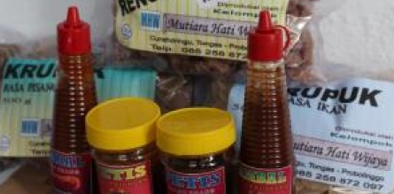
Case study – MFF, Coastal Asia
Project objectives
Contributing factors
Significant change
To restore coastal ecosystems to a healthy state and build human resilience to secure safe and prosperous coastal communities in the Indian Ocean and the South China Sea regions
Clear link between securing livelihoods and protection of coastal ecosystems and biodiversity
well-founded ecosystem-based approach rooted in local government planning
Action research and learning on the ground with a peer-to-peer exchange
A gender-equality and rights as part of people-centred principle in the design activities and its governance structure
Small-Grant projects benefitted the livelihoods of over 75,000 direct beneficiaries, of which about 50 percent were women
Some national policy changes e.g. In Vietnam mangrove shrimp farming accepted as PES
More integrated coastal zone planning
Shift from sea dykes to softer protection forms
Fish and rice crackers, and other products produced by local communities and women at Bahak Beach, Indonesia © MFF Indonesia
Challenges faced
Coasts exposed to extreme weather hazards (cyclones, storms, the intrusion of salty water, and tsunamis)
long-terms impacts such as erosion, sea-level rise and pollution related to climate change and other changing environmental conditions resulting from human activity
poverty, degraded coastal resources, lack of knowledge and empowerment, and weak governance
Danida influence
Absence of change (in this case beyond the project scope)
Mangrove seedlings take root, Probolinggo, Indonesia © MFF Indonesia
Funding together with other donors
Mid term reviews
Sustainability of national planning/coordination forms in doubt
Lessons learnt
Ecosystem based approach can bring development and climate change adaptation/resilience together
Regional projects should have clear regional rationale and added value
Private sector engagement needs greater priority

Slide 26
Case study – ALP, Kenya (+ Ghana, Mozambique, Niger)
Project objectives
Contributing factors
Significant change
To ensure that community-based adaptation (CBA) approaches for vulnerable communities were incorporated into development policies and programmes in Ghana, Kenya, Mozambique and Niger, with plans in place for replication across Africa.
Global commitment to pro-poor adaptation
CARE’s technical expertise, approaches from other projects, advocacy capacity
Long-standing partnerships with local CSOs
Bottom-up holistic multi-stakeholder approach linked with tangible livelihoods improvements
Flexible implementation approach based on learning by doing
Opportunities for learning provided for stakeholders
Access to better local weather and climate information
Participatory local planning and scenario building
Farmers better able to adapt to weather events
Women enabled to travel and work outside homes.
Community based adaptation better integrated in national policies, planning, budgeting.
Replication in other countries
CBA adopted by ECOWAS, COMESA
CBA enhanced in UNFCCC discourse, GCF funding
Better global CSO CBA approaches
Challenges faced
Available approaches and tools inadequate for analysing climate change impacts and promoting effective adaptation in a context of increased uncertainty
Limited availability of local level information/data to inform communities and authorities on appropriate adaptation measures
Poor and most vulnerable, were rarely heard in adaptation decision-making, and the information provided was not adapted to their needs and capacities
Agropastoralist reading climate advisories, Garissa County, Kenya © Eric Aduma, CARE Kenya
Danida influence
Absence of change (in this case beyond the project scope)
Lessons learnt
Bottom-up approaches to CBA can lead to experiences with potential for upscaling and replication
Transformation is associated with community empowerment, combined income-generation
‘Soft’ skills are critical for continued adaptation over time. Hard interventions without decision-making capacity limits the effectiveness of the interventions
The adaptation strategy or technology chosen has less influence on resilience than an informed decision-making
Funding together with other donors
Donors allowed flexibility
Sustainability and replication of CBA planning approach – continuation dependent on donor/project funding
26

Slide 27
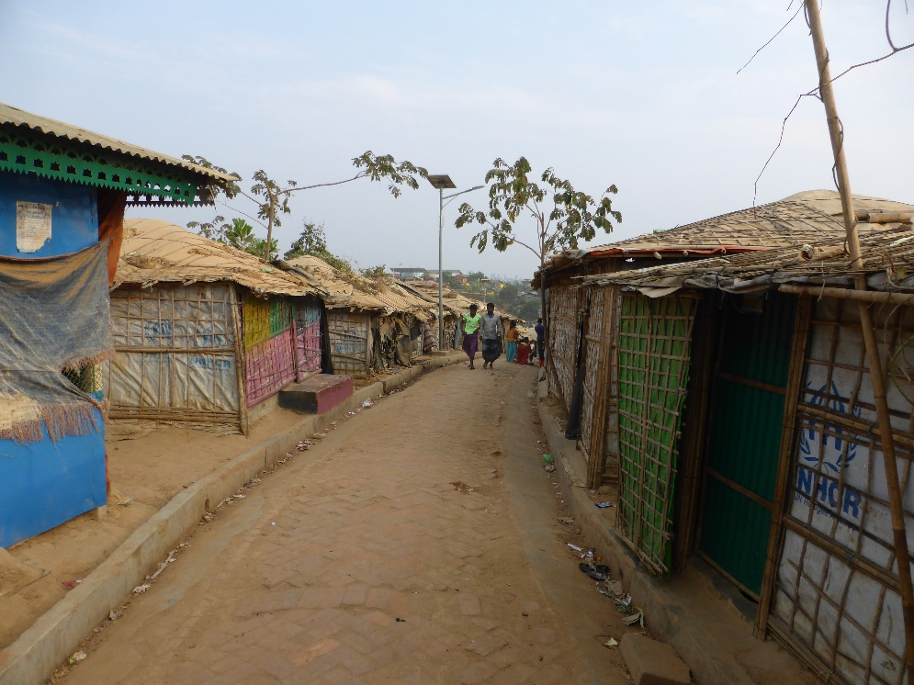
Case study – ALRD, Bangladesh
Project objectives
Contributing factors
Significant change
To support vulnerable groups, especially women and the landless, to secure rights over their livelihoods as environmental conditions change through shifts in climate patterns.
ALRD has worked on land and water issues in Bangladesh since 1991
ALRD has a network of more than 200 CSO partners working at the grass roots that provide legitimacy for ALRD to channel local concerns up to national decision makers
ALRD staff have legal expertise that underpin the credibility of their advocated reforms
Marginalised communities affected by climate-induced displacement have been supported with legal advice
In areas subject to climate-related disasters land resource allocation has been made more equitably
Food security has been strengthened under condition of changing weather patterns
Legal change has been secured that will contribute to reduced levels of atmospheric pollution and deforestation
Challenges faced
Access to land and other natural resources is contested in rural Bangladesh
The damaging effects of climate change are already apparent on both land and water, with increasing salinity of agricultural land and changes to upstream water supply that is having an impact in coastal deltas
Danida influence
Absence of change (in this case beyond the project scope)
Displaced people: a Rohingya refugee camp
Denmark is perceived by the implementing organisation as a trusted long-term partner through the shared values of: (i) a rights-based approach to development, (ii) an emphasis on results, (iii) holding a long-term view on development
Local political processes that are resistant to change
Further large-scale displacement of vulnerable communities
Lessons learnt
Support to credible organisations working to improve public governance for vulnerable and disadvantaged groups can build on their own agenda to address climate change
The national credibility of non-government organisations is a necessary pre-condition if project activity is to be influential
27
27

Slide 28

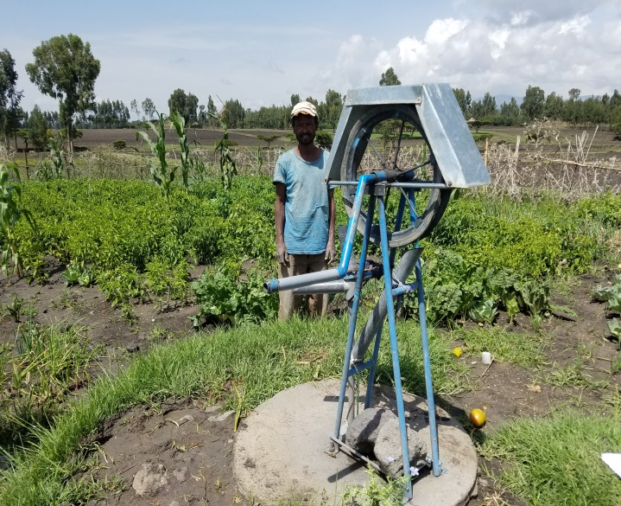
Case Study – GATE-ATA, Ethiopia
Project objectives
Contributing factors
Significant change
Agricultural systems and services promote climate smart agriculture (CSA)
Strengthening market systems and services related to CSA
Human and institutional capacity to promote CSA enhanced within ATA and partners
ATA’s high level technical capacity and political capital
Involving and directly contracting the private sector, particularly farmers unions, was an important success factor for different pilot projects
The ATA contributed by supporting CCA-related targets into the second Growth and Transformation Plan
Demand for further mainstreaming of CSA into Ministry of Agriculture strategies is reported to have emerged
Organizational changes were made to facilitate effective mainstreaming of climate change adaptation within the ATA
Several pilot actions Strengthening market systems and services related to CSA were reportedly upscaled
Input Voucher System – Source: ATA, GATE Final Report
Challenges faced
Smallholder agricultural productivity remains low and highly sensitive to climate variability, particularly for cereal crops
Constraints limit CSA implementation, including capacity and coordination challenges
ATA efforts to mainstream CSA had not progressed significantly from 2011 to 2014
Danida influence
Being a flagship programme, the ATA engagement received significant attention from the Embassy and the MFA in terms of technical backstopping and support.
Danish support to the ATA was significant in terms of strengthening ATA’s coordination function
Absence of change
Well drilling service provision – Source: ATA, GATE Final Report
Limited information remains available on the impact on farmer’s resilience to climate variability and change
Research work suggests that actual priority given to CSA is not as high as suggested by formal policy objectives
Lessons learnt
High level of MFA and Embassy engagement was key
The choice of the ATA as a strategic partner, and providing flexible and committed support to an institution that combined innovation and transformation mandates
Sustainability and upscaling prospects though combining private sector engagement and institutional support
28
28

Slide 29
Case Study – PAGIRE: Integrated Water Resources Management Support Program, Burkina Faso
Case study – Burkina Faso
Project objectives
Contributing factors
Significant change
Capacities of the Water Agencies and other stakeholders are strengthened;
Participation and ownership of the management of water resources by users and other stakeholders;
Protection of water resources against overexploitation and pollution and against siltation and invasive plants
Legal status, staff turnover, lack of financial and administrative autonomy of water agencies reduce their capacity to implement their mission.
Complementarity with other DP, with in particular the EU cooperation providing more direct support to CLE (Local Water Comities) and local level water resources management through NGOs.
CCA and conflicts prevention are now central to the Water Policy and IRWM national programme.
IRWM related institutional development has progressed under resources constraints (e.g. growing number of CLE)
Water resources payments by users to water basin agencies has made progress
The « Water Police » pilot is considered successful, and consensus is building up to support scaling up
Challenges faced
In a context of growing conflicts over water resources, sustainable management and equitable access is security priority.
Climate changes associated to uncertainties, and potentially additional constraints on available resources.
If projections conclude that climate changes are likely to contribute to reduce availability of over-ground water resources, such results are fragile due to limitations in available empirical data.
Danida influence
Sustained and coordinated support to national commitment through a programme approach by Swedish and Danish cooperation has contributed to institutional and legal developments.
Complementarities with the Governance programme have been developed to support strengthening of the social contract around water management and access.
Absence of change
Anti-erosion filter dam, Lumbilla – Evaluation team
Despite a growing number, CLE lack capacities and resources to implement their responsibilities.
Autonomy of water basin agencies is far from being attained.
Water resources protection and conflict prevention objectives are either not effectively monitored or much lower than planned
Lessons learnt
Acknowledged climate change / conflict nexus, but lack of information and solid projections remains a weakness.
High relevance of programme approach to support systems and institutional development at scale, but limitations with respect to water monitoring systems and support to local users groups
Difficulties to assess the impact of the dedicated Governance programme to operationalized HRBA in the water sector
29
29
29

Slide 30
Overview of sampled projects
Sample Project |  | Type
 |  | CE | Non CE ODA | NGO | Multilateral
B1 | Bangladesh Climate change resilience fund (BBCRF) |  | x
B2 | Water supply and sanitation (HYSAWA) | x | x
B3 | Climate Change Adaptation Project Phase II (LGED) | x | x
B4 | Adaptation and disaster risk education (Action Aid Bangladesh) |  | x | x
B5 | Coastal Climate Resilient Infrastructure Project (PPCR) |  | x |  | x
B6 | CHT Climate Resilience Project (CCRP) |  | x |  | x
BF1 | Adaptation aux changements climatiques en vue de l'amélioration de la sécurité humaine du Burkina Faso. (UNDP) |  | x |  | x
BF2 | Sector Programme for Agriculture (MoA) |  | x
BF3 | Dialogue on Private Climate Financing (Oxfam Ibis and SOS Sahel) |  | x | x
BF4 | Appui a la mise en æuvre du PANA (UICN) |  | x | x
BF5 | Restauration et amelioration de la productivite de peuplements de karite au BF (INERA) |  | x
BF6 | Gestion Intégrée des Ressources en Eau (MEA / DGRE) |  | x
E1 | GATE (CRGE) | x
E2 | GATE (ATA) |  | x
E3 | Livelihood and resilience (DCA) |  | x | x
E4 | Early warning systems (LDCF) |  | x |  | x
E5 | Mengella Environmental Conservation and Livelihood (SSD) |  | x | x
K1 | Northern Rangeland Trust (NRT) | x | x
K2 | Water Services Trust Fund (WSTF) | x | x
K3 | Greening Development (NEMA) |  | x
K4 | Kenya Climate Innovation Centre (KCIC) |  | x
K5 | Adaptation Learning Programme (ALP, CARE) | x |  | x
K6 | Community Development Trust Fund/Community Environment Facility (CDTF/CEF) | x | x
K7 | Office of the Prime Minister (OPM) |  | x
R1 | Mangroves for the future (MFF) | x |  | x | (x)

