Slide 1
Danish Biodiversity-Relevant Development Finance – IDA Presentation
Hans Peter Dejgaard
INKA Consult
15/06/21

Slide 2
Contents
1 - International Biodiversity Finance Target
2 - Global Progress to the target
3 - Danish contributions to the target & how Denmark compares to other countries
4 - Report Recommendations
5 - Kunming 2021 – What next for biodiversity finance?

Slide 3
https://politiken.dk/indland/art8242508/Dansk-bistand-til-biodiversitet-er-mere-end-halveret

Slide 4
1 – “The Hyderabad Commitments” (Aichi Target Element 20a)
The Aichi Targets (2011-20)
Strategic Goal E: Enhance implementation through participatory planning, knowledge management and capacity building
Target 20: Mobilizing Resources from all Sources
Target Element 20a: Double international finance flows by 2015 (and at least maintain this to 2020), compared to the 2006-10 average
Target endorsed by Denmark & EU, but no formal obligation for Denmark to double its biodiversity finance.
https://www.cbd.int/doc/world/dk/dk-nbsap-v2-en.pdf
Notes:
Aichi Targets: 2011-2020, adopted by the EU Biodiversity Strategy.
Strategic Goal E: Enhance implementation through participatory planning, knowledge management and capacity building
Target 20: Mobilizing Resources from all Sources
Element a of Target 20: (Hyderabad Commitments) is to double international finance flows by the year 2015, and maintain that doubling up until 2020. That doubling would be in comparison to a baseline which is the average of 2006-2010.
To be reported to the UNCBD Financial Reporting Framework every second year as aggregated data (just the totals).
Extra info…
This target was adopted at COP 12 – Pyeongchang in 2014. At the same COP, the reporting framework was also adopted.

Slide 5
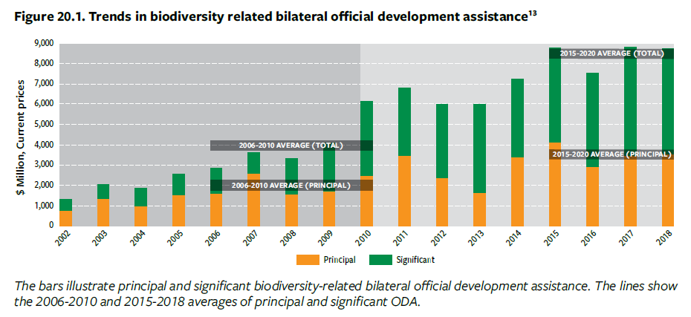
2 - Global Progress to Doubling Biodiversity Finance (OECD data)
+130%
Our estimation: +99%
“Financial resources available for biodiversity through international flows and official development assistance has roughly doubled.” GBO5 (p123)
“Overall, DAC members that are Party to the CBD collectively doubled their biodiversity-related funding by 130 % from the baseline to 2015” WWF Barometer report (p14)
Notes:
PROBLEM – reporting to UNCBD is not good (latest figures from 2015, UNCBD still asking for reports from some parties for 2016-17 period).
There will be a report due from the UNCBD secretariat on the reported amounts to the UNCBD framework, published for COP15.
ALTERNATIVE: CRS data is available up to 2019, can use that to estimate progress (UNCBD utilise OECD figures).
Claim of 104% from UNCBD GBO by 2015. Headline = the bigger donors have been increasing their biodiversity finances by double, and some cases over double, e.g. United Kingdom, France, Germany, Norway x3.
Importantly – these are estimates. There are differences between what donors report to OECD and UNCBD. Generally, donors report more to the UNCBD than to the OECD. Captures other flows (e.g. OOF)
Extra info...
While 28 countries have reported their biodiversity-related ODA and OOF through the CBD financial reporting framework under section one “international financial resource flows”, the majority of entries date to 2015. Only 11 countries have provided information on international flows from 2016-2017.
1. The estimate for international public finance for biodiversity was calculated from the commitments reported by DAC and non-DAC member providers to OECD CRS database
The mid-range estimate includes 100% of principal flows and applies a coefficient of 40% to the flows marked as significant, which is consistent with the approach taken by many donor countries in their CBD financial reports.

Slide 6
3 - DK Contribution to the International Finance Target - Commitments
Note: 2018 and 2019 finance is not yet officially reported to the UNCBD, and is therefore an estimate from CRS data.
Notes:
Denmark – moved now to DKK million (instead of USD).
Note: 2018 and 2019 finance is not yet reported, and is therefore an estimate.
GLOBALLY: 63% of biodiversity finance provided as significant, 37% principal. Clearly not the case for Denmark.
Big story here = the last 4 years in particular are very low. 2019 is the lowest of any year we looked at, going back to 2006
Relatively high baseline – as Denmark were quite strong on this issue in the years 2006-10

Slide 7
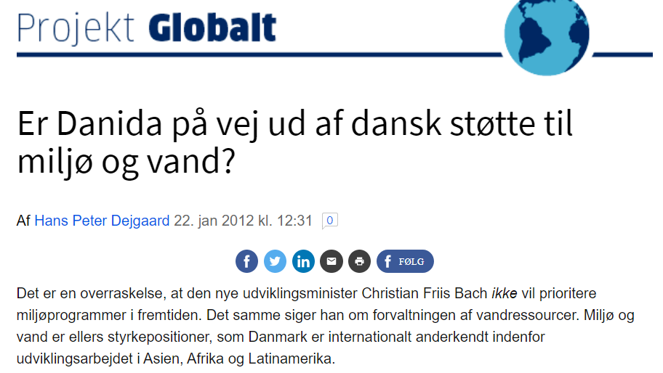
3 – Why has DK biodiversity finance dropped?
https://ing.dk/blog/er-danida-paa-vej-ud-af-dansk-stoette-til-miljoe-og-vand-126018

Slide 8
4 – How does Denmark Compare? (Latest reported figures to UNCBD - 2015)
Notes:
PROBLEM – reporting to UNCBD is not good (latest figures from 2015, UNCBD still asking for reports from some parties for 2016-17 period).
There will be a report due from the UNCBD secretariat on the reported amounts to the UNCBD framework, published for COP15.
(Explain graph)
Coefficient for all donors reporting in 2015 was 1.7x
Extra info
Reporting methods vary!
Japan uses 100% coefficient for significant Rio Markers.
They’re also generous with their application of the Rio Markers. Trend we see in Climate Finance also.

Slide 9
4- Report Recommendations
The new Danida strategy demonstrates increased attention to biodiversity in Danish development cooperation, including linkages to climate change and other sectors.
Denmark urgently increases its biodiversity ODA finance commitments over the coming 1-3 years in line with Aichi Target 20a, to make up for shortcomings in recent years.
The Danish government prepare an ambitious financial pledge in support of the post-2020 global biodiversity framework to be adopted at the upcoming COP15 negotiations in Kunming, China. Aiming at establishing Denmark as a progressive global actor willing to respond to the funding needs outlined in the new UNEP’s State of Finance for Nature report (tripling investments in nature-based solutions by 2030).
Denmark advocate for improved and internationally harmonised formats, template, and guidelines in relation to the methodology, provision, and reporting of relevant biodiversity financing to developing countries. This should be prioritised for negotiation at COP15 (and other relevant fora, such as the OECD and EU), using the OECD’s five key recommendations as a basis (source: A Comprehensive Overview of Global Biodiversity Finance, OECD 2020).
Denmark improves its own reporting methodologies in line with good practice by implementing a granular assessment methodology for tracking biodiversity flows, in line with OECD recommendation #1.
State of Finance for Nature: UNEP, the World Economic Forum and the Economics of Land Degradation (27 May 2021). https://www.unep.org/events/publication-launch/state-finance-nature-tripling-investments-nature-based-solutions-2030
Notes:
1. The current Danida strategy ‘Verden 2030’ is relatively weak on biodiversity. With the new Danida strategy being formulated in 2021, there is an opportunity to significantly increase Danish biodiversity interventions and finance, including mainstreaming into other sectors.
“Nevertheless, climate-related ODA for biodiversity conservation efforts such as natural climate solutions remains significantly underfunded relative to the potential contribution that the land use sector can make to climate mitigation (see section on Nature-Based Solutions and Carbon Markets). Recent analyses indicate that up to 30% of the world’s cost-effective, near-team mitigation potential can be provided by the landuse sector by stopping deforestation, restoring forests, and improving agricultural practices.”
2. Make up for the disappointing levels of biodiversity finance over the past 10 years.
3. More future looking, need to show that Denmark is serious about biodiversity. The opportunity to do so is available at Kunming. We’ve lost a year because of covid, so waiting for a new collective goal to inform Denmark’s own ambitions is perhaps problematic. As we see with many of the previous pledges they are for a time in the future e.g. Doubling by 2015. So there needs to be an interim ambition to get Denmark back on track, and set Denmark up to meet the new collective ambitions, whatever they may be.
4. Needs to be harmonisation of reporting methods at the UNCBD level.
5. Denmark needs to improve its won methods to be granular assessments.

Slide 10
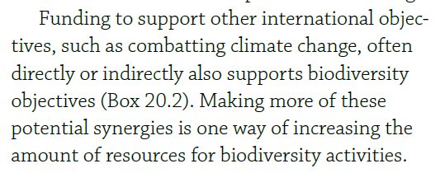
Opportunities for resource mobilisation through climate synergies
96% of all Danish biodiversity-relevant finance also considered climate-relevant
Synergies through: Ecosystem-based mitigation and adaptation activities & nature based solutions
Global Biodiversity Outlook 5 - UNEP

Slide 11
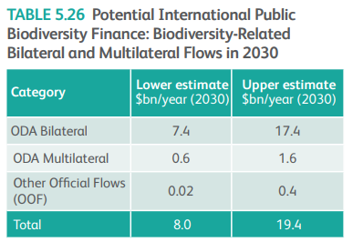
5- Post-2020 Global Biodiversity Framework – Kunming 2021
October 11-24, 2021
Paulson Institute Recommendation for Post-2020 Target:
“The CBD’s biodiversity donors should double biodiversity-related ODA to support the implementation of the forthcoming Global Biodiversity Framework.”
https://www.paulsoninstitute.org/wp-content/uploads/2020/10/FINANCING-NATURE_Full-Report_Final-with-endorsements_101420.pdf
Notes:
At COP15 in Kunming, a new post-Aichi set of targets will be discussed – called Post-2020 Global Biodiversity Framework. Including the issue of resource mobilisation.
There is not much information to go on what the post-2020 financial targets might look like if they are made. The Paulson Institute made the recommendation to double again to 2030. “Double the doubling”.

Slide 12
Resources
http://www.oecd.org/dac/environment-development/Biodiversity-related-ODA.pdf - BIODIVERSITYRELATED OFFICIAL DEVELOPMENT ASSISTANCE 2015
https://www.oecd.org/environment/resources/biodiversity/report-a-comprehensive-overview-of-global-biodiversity-finance.pdf - A Comprehensive Overview of Global Biodiversity Finance (OECD, April 2020)
https://public.tableau.com/views/RioMarkers/ByProvider?:embed=y&:display_count=no&%3AshowVizHome=no%20#3 – OECD Data Visualisation Portal
https://www.cbd.int/doc/meetings/fin/rmws-2016-01/other/rmws-2016-01-presentation-1-en.pdf - UNCBD presentation on Reporting Framework
https://www.cbd.int/meetings/SBI-03 - Meeting Documents, Third meeting of the Subsidiary Body on Implementation
https://www.cbd.int/doc/c/efb0/1f84/a892b98d2982a829962b6371/wg2020-02-03-en.pdf - Zero draft - post 2020 Global Biodiversity Framework
https://www.cbd.int/doc/c/2c34/9558/f1487764d65e89bafb74d8fa/sbi-03-05-en.pdf - Subsidiary Body on Implementation – Resource Mobilisation

