Slide 1
The status and future of Biodiversity
Carsten Rahbek
Professor and Centerdirector
Center for Makroøkologi, Evolution and Klima, Københavns Universitet
Villum Center for Global Mountain Biodiversity
Adjungeret Professor D-IAS, University of Southern Denmark
Visisting Professor, Imperial College, London
Professor, Peking University
GLOBE Institute

Slide 2
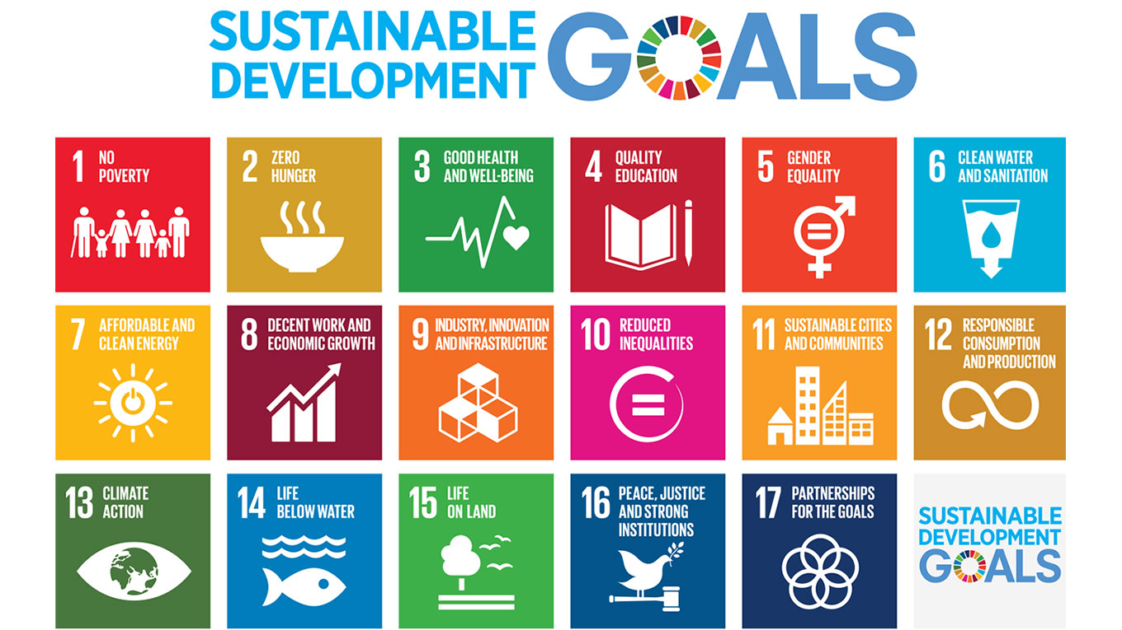
E-mail: crahbek@snm.ku.dk
Twitter: @Carsten_Rahbek
Notes:
2

Slide 3
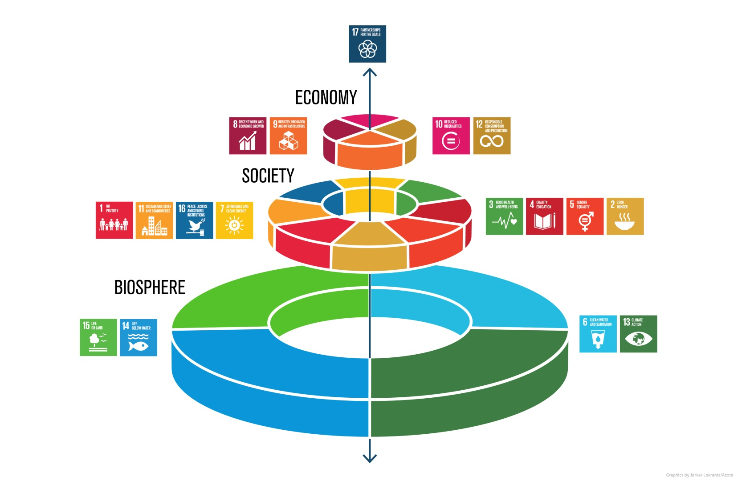
E-mail: crahbek@snm.ku.dk
Twitter: @Carsten_Rahbek
Notes:
3

Slide 4
E-mail: crahbek@snm.ku.dk
Twitter: @Carsten_Rahbek
Biodiversity Convenstion 1992
Al species has a rigth of existence
og resources should be used suistainable
EU and UN has all
committed in 2001 and in 2010
to 20 globale biodievrsity targets
and to halt the loss of biodiversity before 2020
Notes:
4

Slide 5
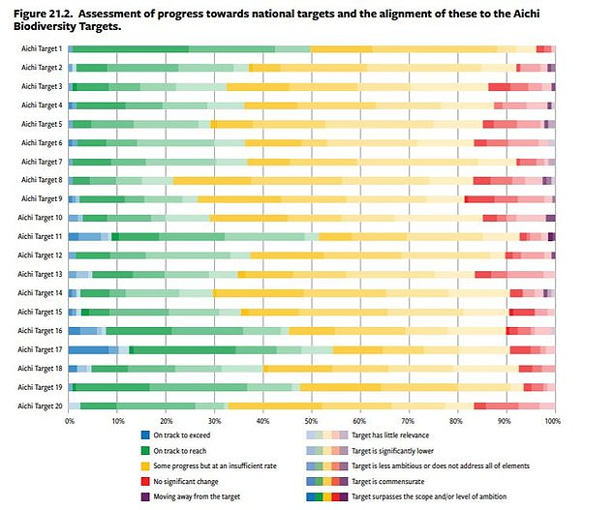
E-mail: crahbek@snm.ku.dk
Twitter: @Carsten_Rahbek
Notes:
5

Slide 6
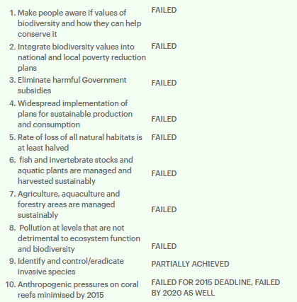
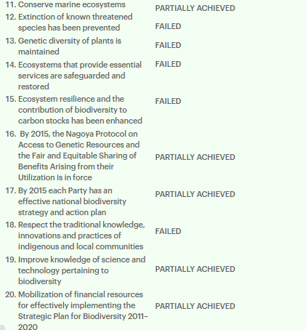
E-mail: crahbek@sund.ku.dk
Twitter: @Carsten_Rahbek
Hvordan er det gået med de 20 Aichi Mål

Slide 7
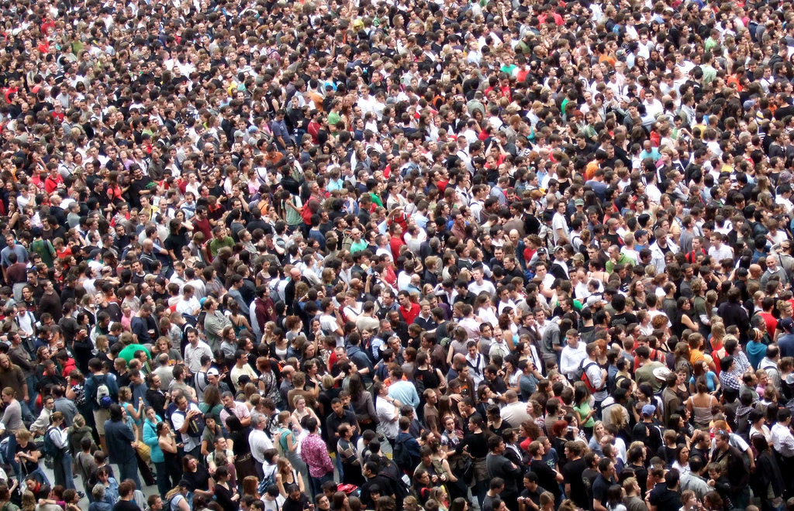
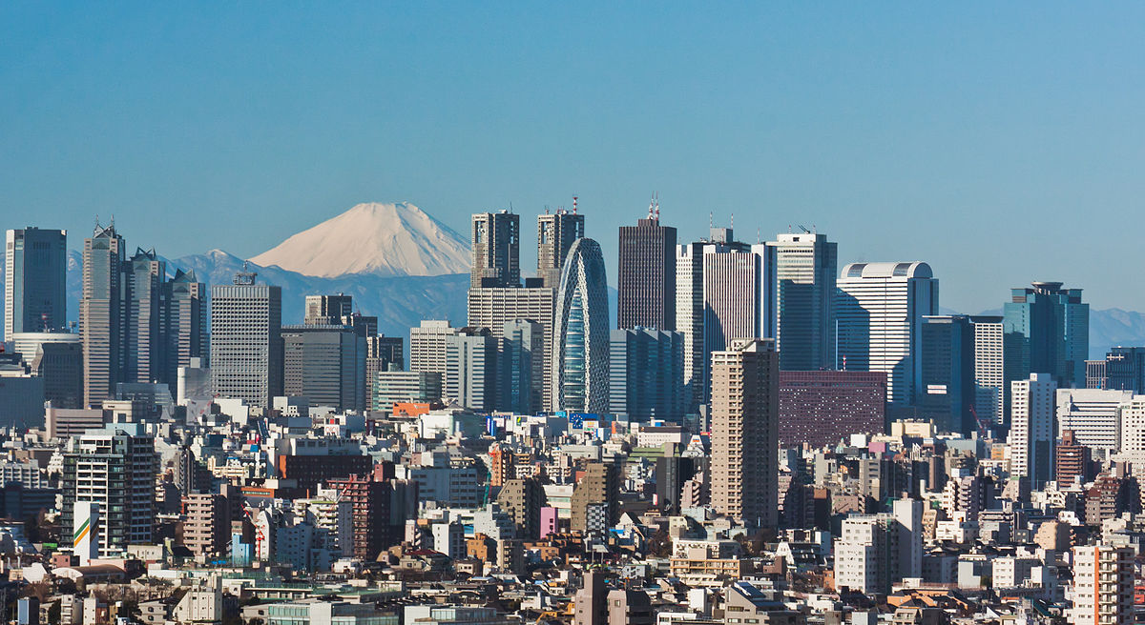
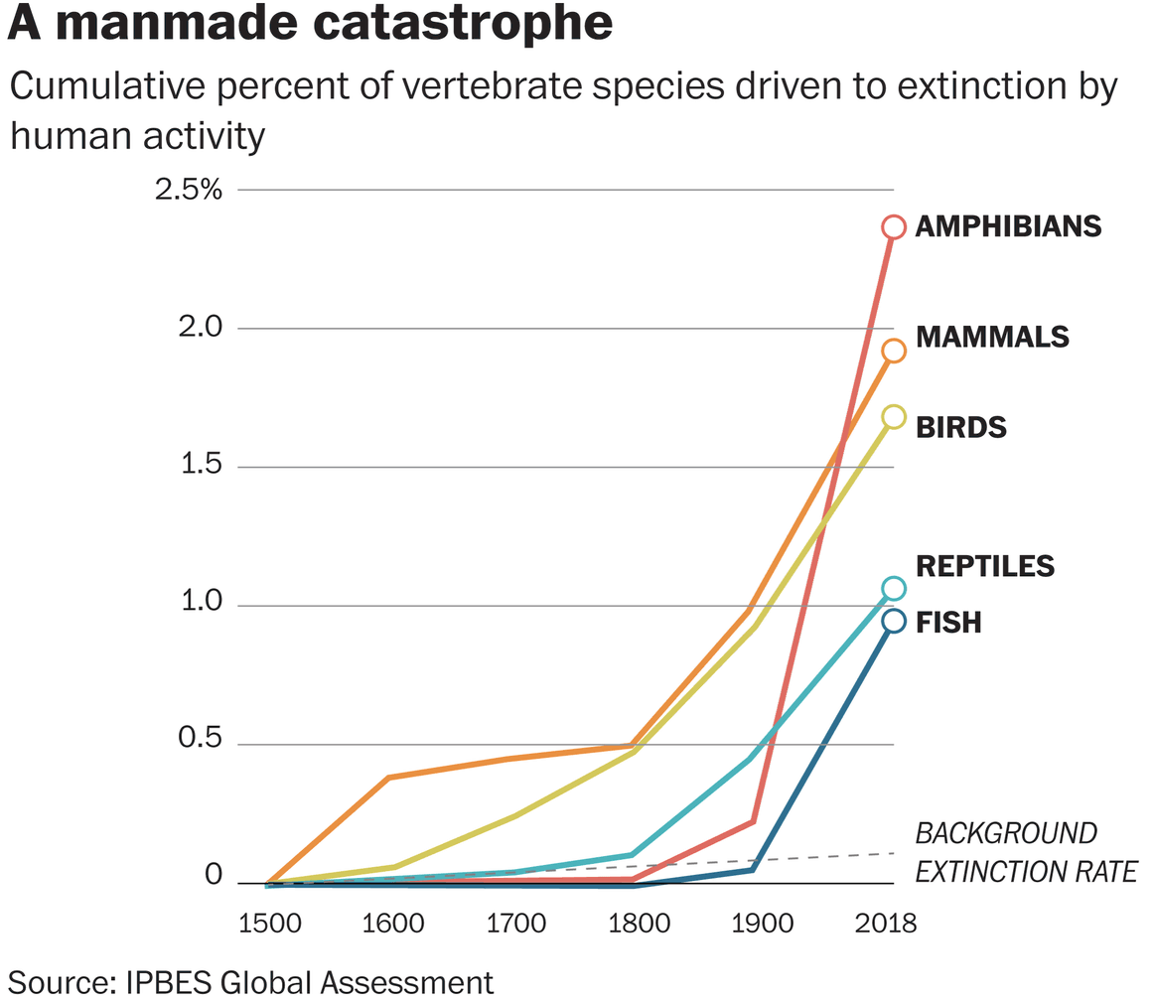

Slide 8
E-mail: crahbek@snm.ku.dk
Twitter: @Carsten_Rahbek
E-mail: crahbek@snm.ku.dk
Twitter: @Carsten_Rahbek
The Biodiversity Crises

Slide 9
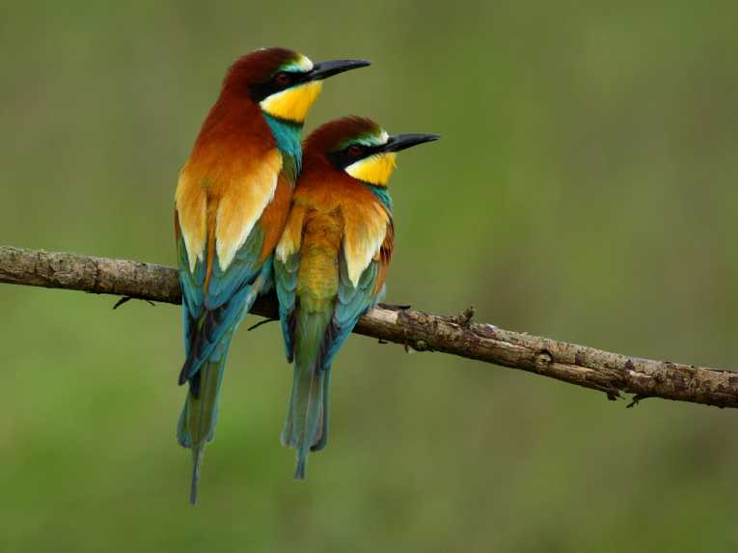
E-mail: crahbek@snm.ku.dk
Twitter: @Carsten_Rahbek
E-mail: crahbek@snm.ku.dk
Twitter: @Carsten_Rahbek
We loose species at a rate 100-1,000 times greater
than the normal extinction background rate
We live in the 6th period of mass extinction

Slide 10
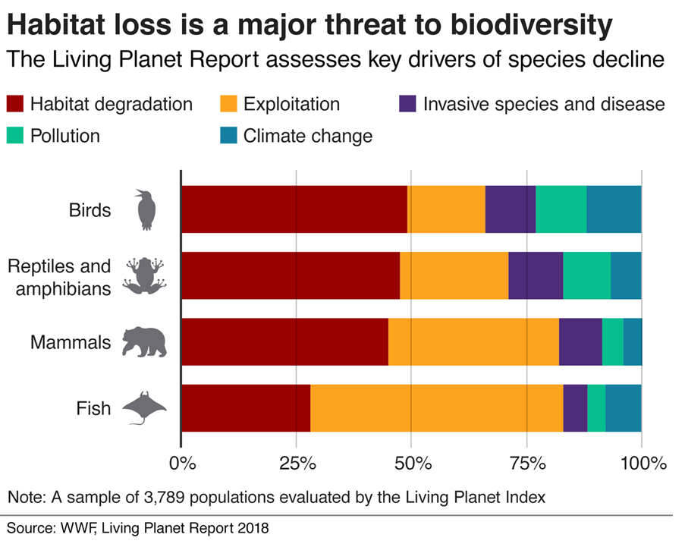

Slide 11
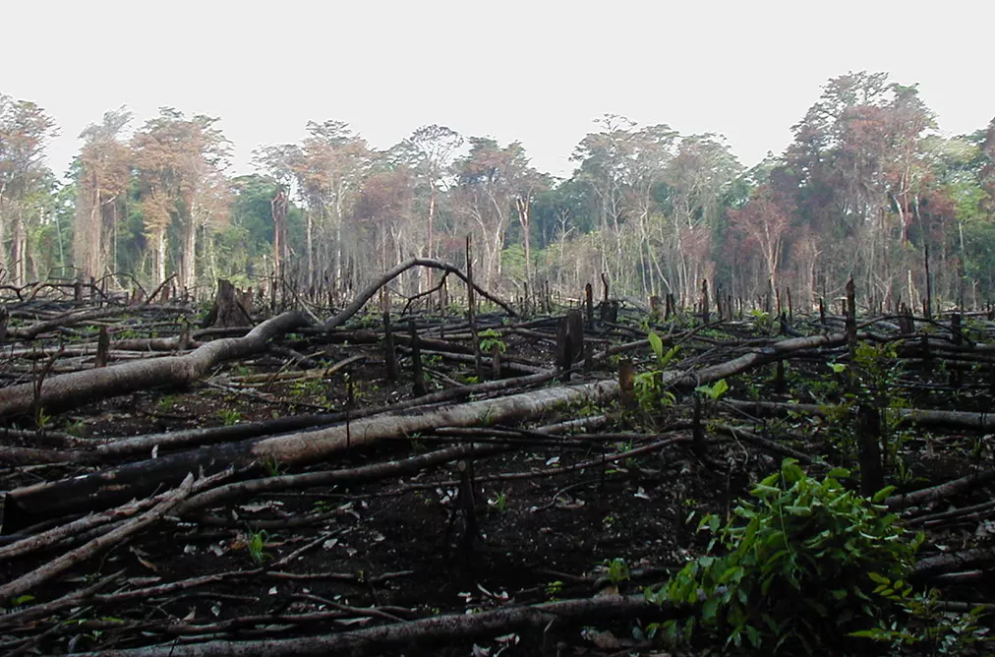
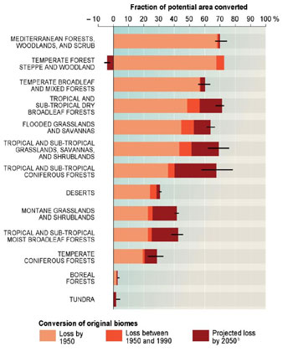
Loss of habitats for species to thrive in
30-70% of the Earths
ecosystems
are degraded

Slide 12
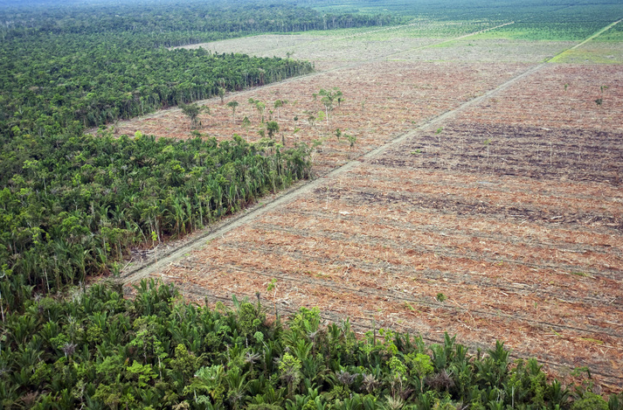

Slide 13
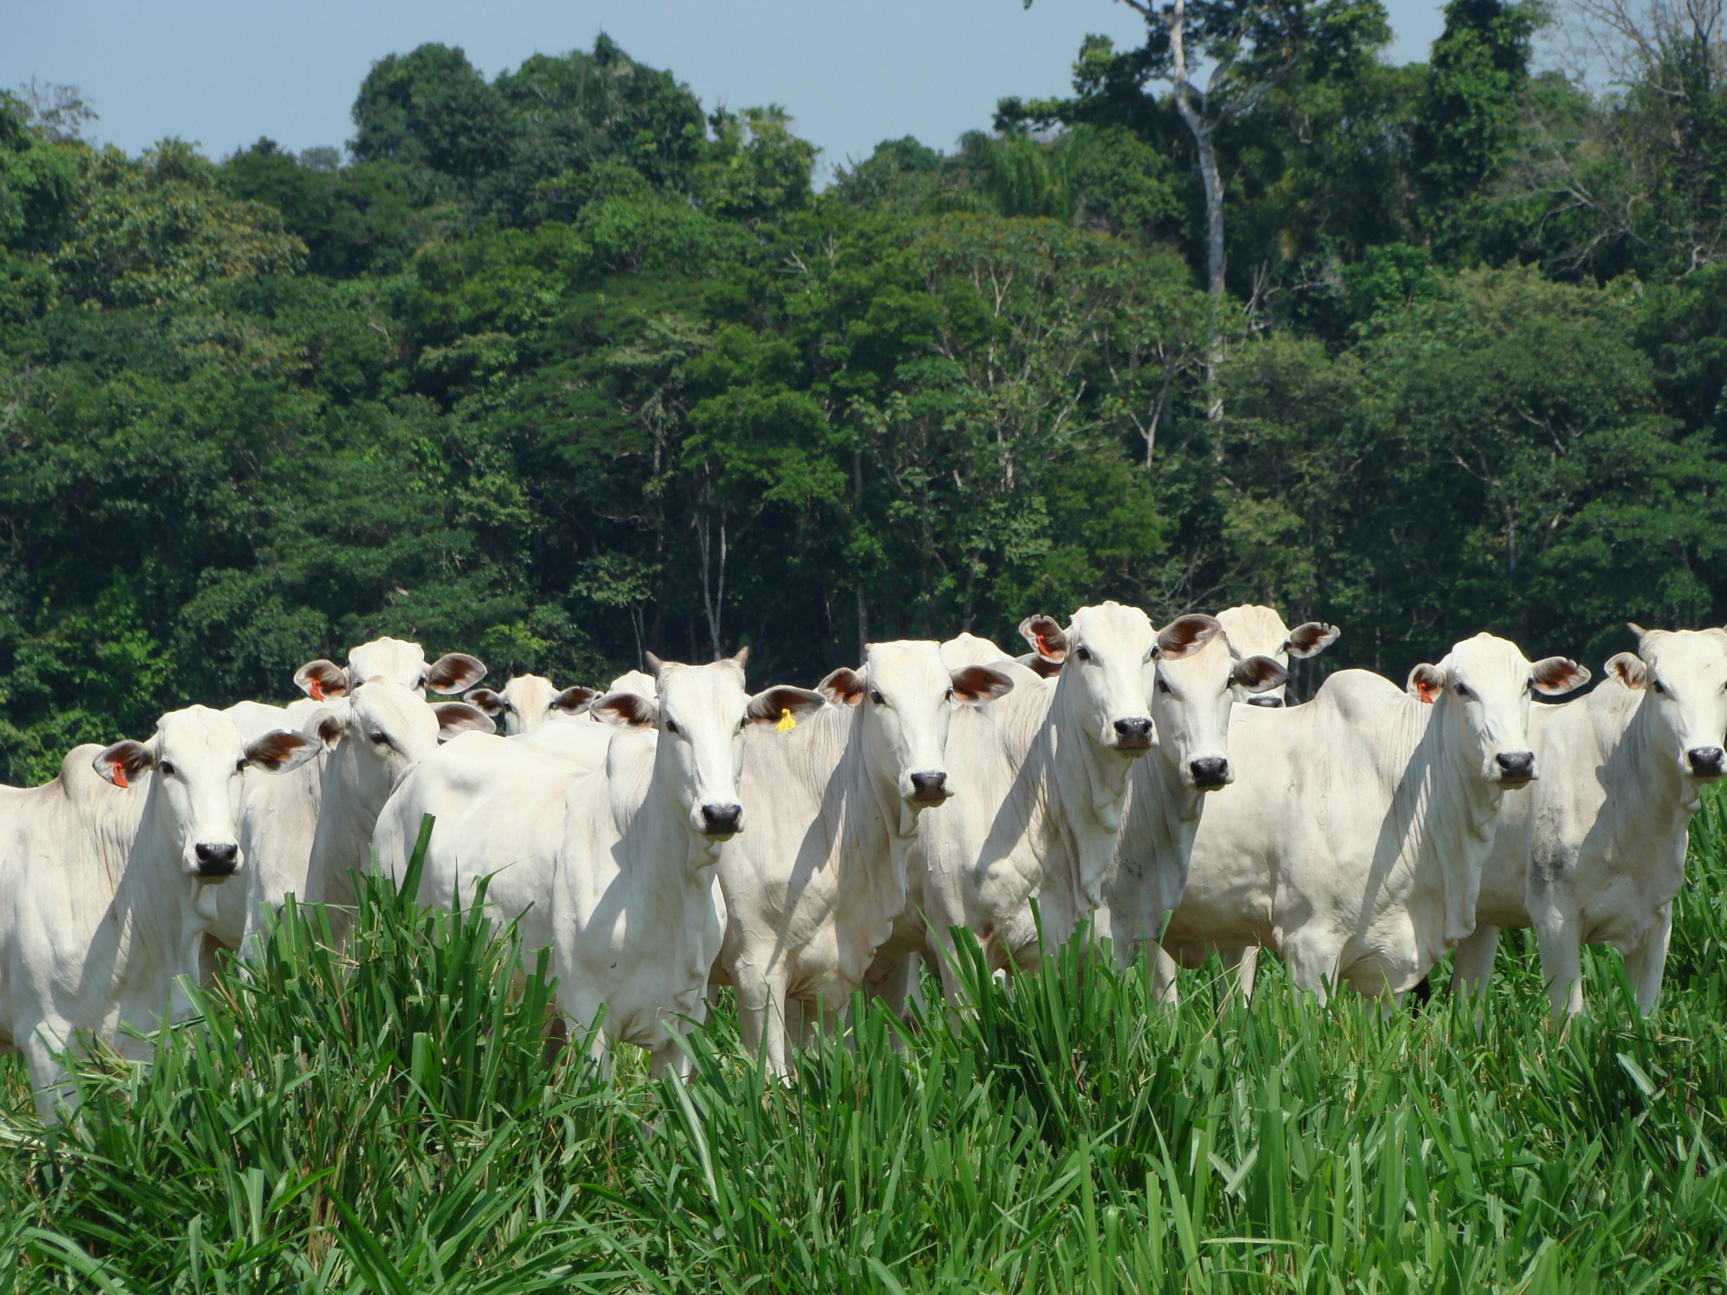
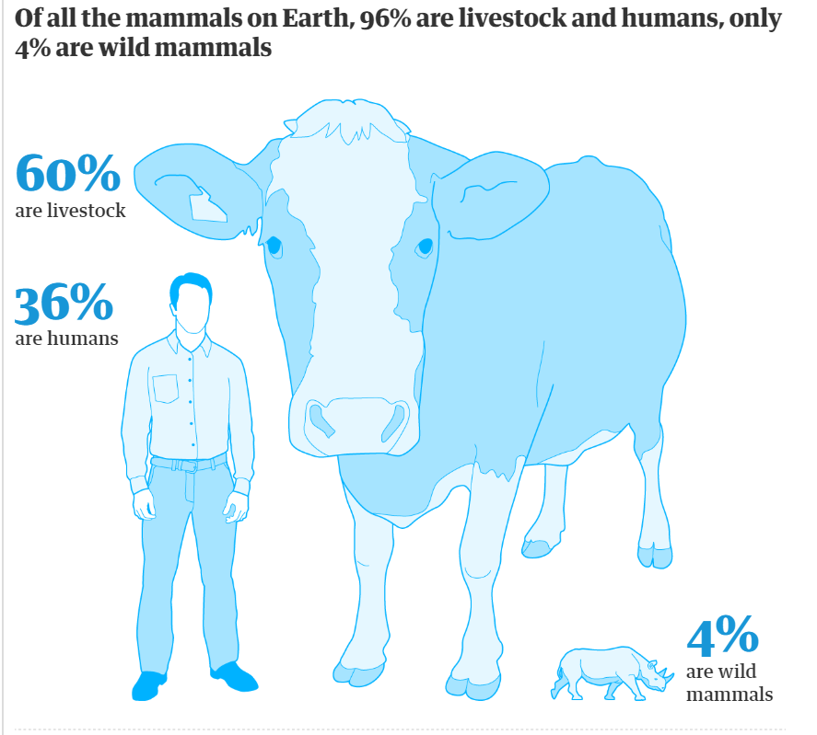
75% of all chemotherapy drugs
has components first discovered in amazonian plants

Slide 14
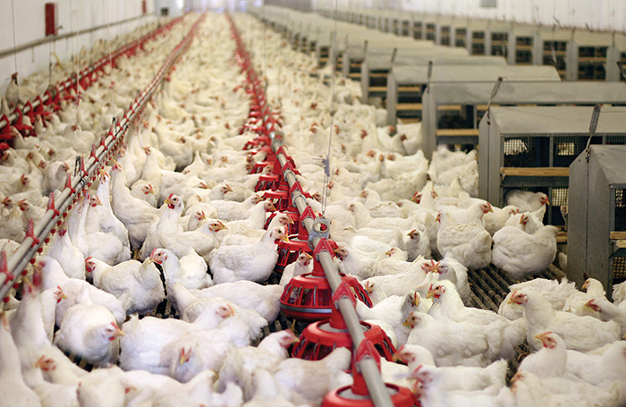
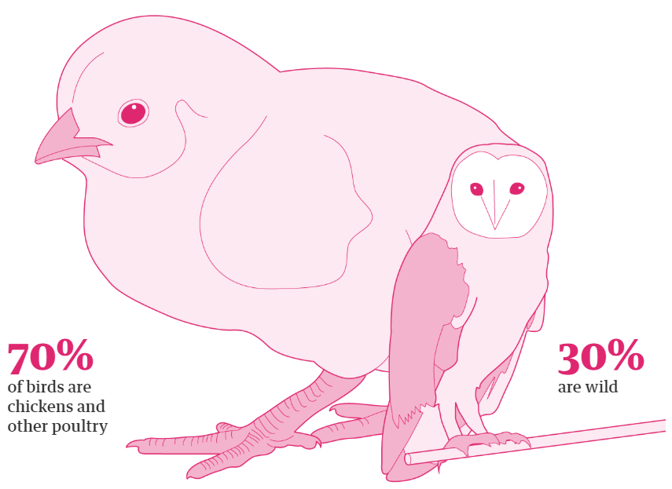

Slide 15
E-mail: crahbek@sund.ku.dk
Twitter: @Carsten_Rahbek
Land degradation is a major contributor to climate change.
Climate change can exacerbate the effects of land degradation.
Deforestation and loss of fresh water bodies = 25% of all human-induced greenhouse gas emissions.
Halting and reversing land degradation can provide more than 1/3 of the most cost-effective greenhouse gas mitigation activities to keep global warming under 2°C
The combination of land degradation and climate change projected to reduce global crop yields by 10% (up to 50%in some regions) by 2050, forcing up to 700 million people to migrate
The Intergovernmental Platform on Biodiversity and Ecosystem Services www.ipbes.net

Slide 16
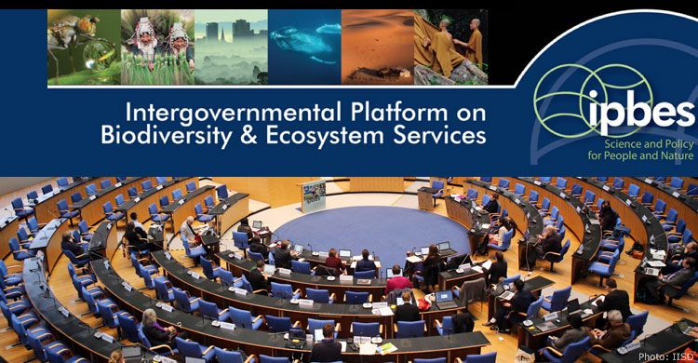
E-mail: crahbek@sund.ku.dk
Twitter: @Carsten_Rahbek
> 130 countries

Slide 17
E-mail: crahbek@sund.ku.dk
Twitter: @Carsten_Rahbek
IPBES: Science - policy
Biodiversity
Economy
People / society

Slide 18
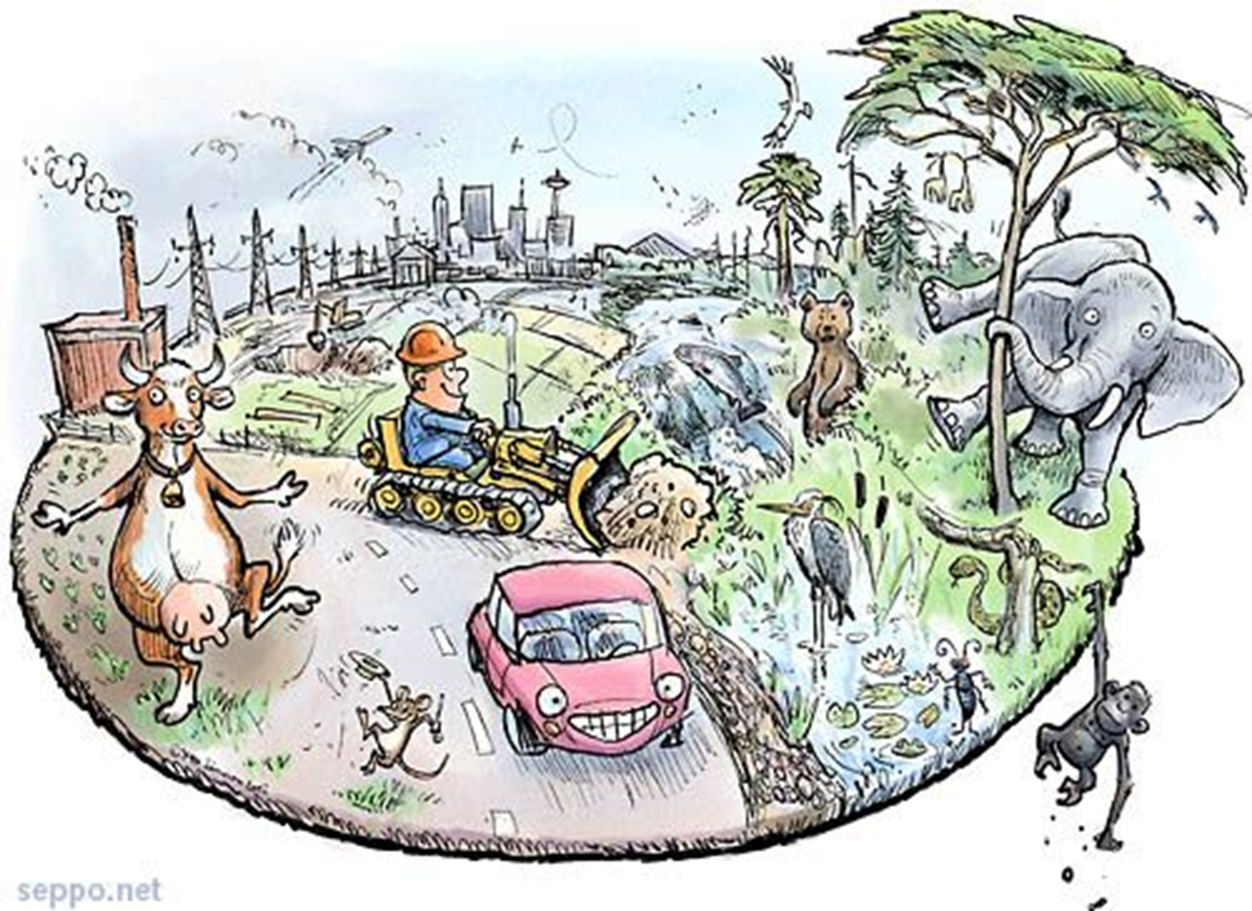
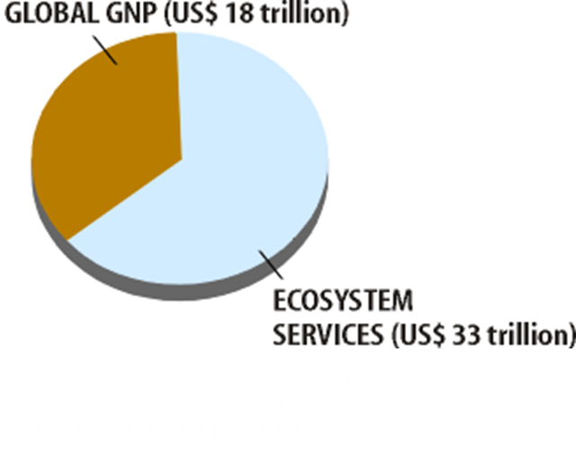
E-mail: crahbek@sund.ku.dk
Twitter: @Carsten_Rahbek
Can we afford to preserve Biodiversity ?
The natural ecosystems, created and maintained by biodiversity, provides goods to people
food,
clean water,
nutriet circulation,
carbon-storage,
polination,
recreation,
healt.
Biodiversity contributes with 30-50% of the global GNP that humans consumes every year.
TEEB reports to the EU commision
UNEP Millennium Ecosystem Assessment 2005
IPBES reports 2018, 2019

Slide 19
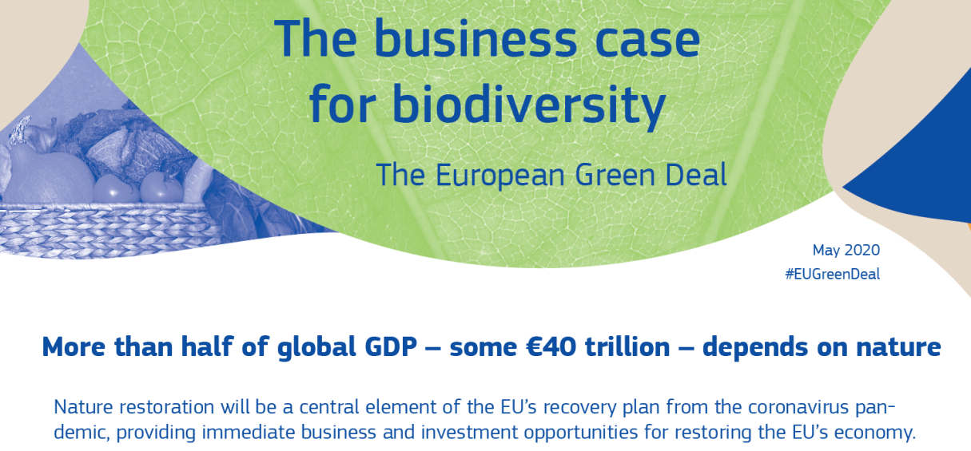

Slide 20
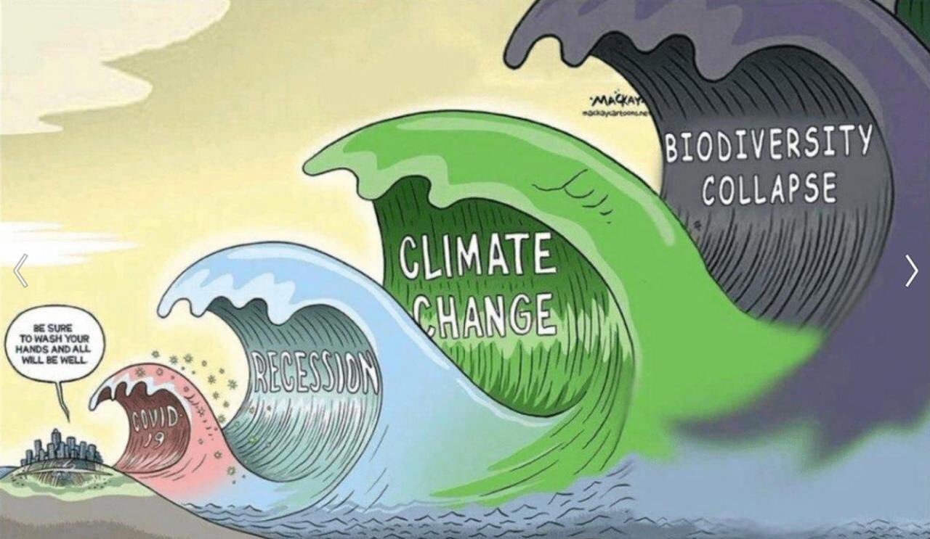
E-mail: crahbek@sund.ku.dk
Twitter: @Carsten_Rahbek
Notes:
20

